Slide 1



LIFECYCLE END-TO-END PROCESS
May 2026
Digital Products -
IT Business Solutions Delivery

Slide 2
LIFECYCLE END-TO-END PROCESS
May 2026
Digital Products -
Context
01
Overview of the current situation, key challenges, and objectives driving the initiative and design principles for the lifecycle process
Methodology
02
Structured approach outlining phases, activities, and inputs used to assess the current state and define the target model
Lifecycle Model
03
Definition of the end-to-end product lifecycle, including demand typology, value-based prioritization, governance (RACI), and enabling tools
Portfolio Concept Blueprint
04
Target portfolio structure and tool ecosystem, including key gaps and conceptual design for integrated portfolio management
Pilot Readiness & Next Steps
05
Key actions to enable implementation, including pilot definition, readiness considerations, and roadmap for rollout
IT Business Solutions Delivery

Slide 3
LIFECYCLE END-TO-END PROCESS
May 2026
Digital Products -
Context
01
Overview of the current situation, key challenges, and objectives driving the initiative and design principles for the lifecycle process
Methodology
02
Structured approach outlining phases, activities, and inputs used to assess the current state and define the target model
Lifecycle Model
03
Definition of the end-to-end product lifecycle, including demand typology, value-based prioritization, governance (RACI), and enabling tools
Portfolio Concept Blueprint
04
Target portfolio structure and tool ecosystem, including key gaps and conceptual design for integrated portfolio management
Pilot Readiness & Next Steps
05
Key actions to enable implementation, including pilot definition, readiness considerations, and roadmap for rollout
IT Business Solutions Delivery

Slide 4
INTRODUCTION
OBJECTIVES OF THE DOCUMENT
Avangrid is consolidating Customer Services Applications and IT Business Applications into a single Digital Products organization — demand fragmentation is the structural risk the Target Operating Model must resolve.
PROJECT SCOPE
OBJECTIVES OF THIS DOCUMENT
Digital Products in scope: IT Business Applications (4 teams, ~26 FTE) and Customer Services Apps (5 teams, ~24 FTE, 2 Sr. Manager vacancies).
Five end-to-end stages assessed per team: Intake → Classification → Prioritization → Portfolio → Delivery.
Baseline grounded in interview evidence and RFI data received from the teams.
Wave 1 delivers: Baseline Report, Demand Map, Portfolio Landscape, Lifecycle v1.0, Jira Config v1.0, and a live BRS pilot.
Provide an overview of the current context, key challenges, and objectives, supported by a structured methodology to guide the definition of the target state.
Define the end-to-end Digital Product lifecycle, including demand typology, value-based prioritization, governance model, and enabling tools.
Design the target portfolio structure and supporting tool ecosystem, identifying key gaps and shaping an integrated portfolio management approach.
Outline the key actions required for implementation, including pilot definition, readiness considerations, and a roadmap for rollout.

Slide 5
INTRODUCTION
CURRENT STATE ANALYSIS SUMMARY
Our assessment highlights opportunities to strengthen alignment, governance, and prioritization across six operating-model blocks — Governance & Strategy · Business Relationship · Build · Run · Data & Analytics · Architecture & Integration.
OPERATING CONSTRAINTS
DELIVERY EXPERIENCE AND PAIN POINTS
STRUCTURAL MISALIGNMENT
These are the structural and operational limitations currently constraining the model’s ability to scale and deliver value consistently.
This section outlines the key factors:
People: Capacity & accountability constrained · Run/Build blended · business-side roles missing (Process Owners, IT Business Partners, Demand Manager)
Process: Standardization gap · Run/Build blended · module silos, not functional domains (Finance · Procurement · Asset Mgmt)
Tools: Fragmented ecosystem · no internal Data & Analytics or Architecture capability
Governance: Fragmented decisions · no ERP Steering Committee · no SAP Enterprise Architect
These are the friction points impacting execution and the business or user experience.
This section describes the main issues identified related to:
  Fragmented demand and intake drive reactive, non-strategic delivery
  Lack of clear product ownership weakens accountability and decision-making
  Limited portfolio visibility constrains end-to-end planning and prioritization
  Uncoordinated capacity and overlapping initiatives reduce efficiency and impact
This refers to the misalignment between the organizational structure, governance model, and the way products are managed and delivered.
This section highlights the structural gaps:
No Product Entry Point
No Value-Based Decision-Making
No End-to-End Product View
No Ownership of Outcomes
No Product-Level Steering
No Common Language of Value
No Product Ownership Model
FUTURE STATE GUIDING PRINCIPLES
They will serve as a decision-making framework for designing processes, roles, and governance aligned with a more scalable, transparent, and product-oriented model.
Demand Intake & Structuring
Value-Based Prioritization
Product Portfolio Management & Planning
Product Governance & Ownership

Slide 6
INTRODUCTION
LIFECYCLE END-TO-END PROCESS GUIDING PRINCIPLES
Four principles guide the Target Operating Model — each answers one of the 7 structural issues and is grounded in prior NTT work with Avangrid
All demand must be captured through a unified intake layer aligned to products or value streams, ensuring full visibility and traceability.
Single entry point per product/value stream
Standard intake criteria and mandatory fields
Consistent demand categorization across teams (type, size, complexity, value driver)
Clear ownership for triage and backlog assignment
DEMAND INTAKE & STRUCTURING
Demand is consistently evaluated and prioritized using a standardized framework tied to business outcomes.
Common scoring model (value, urgency, risk, effort)
Transparent prioritization across competing demands
Product-level backlog ownership
Trade-offs made at portfolio/product governance level
VALUE-BASED PRIORITIZATION
PRODUCT-CENTRIC DESIGN PRINCIPLES
End-to-end visibility enables coordinated planning across demand, capacity, and delivery.
Integrated portfolio view across all products
Capacity planning aligned to product priorities
Roadmaps managed at product level (not project level)
Continuous tracking of delivery and outcomes
PRODUCT PORTFOLIO MANAGEMENT & PLANNING
Clear accountability and governance ensure decisions are aligned to product outcomes.
Defined roles (Product Owner / Product Manager / Tech Lead)
Product-based governance forums with decision rights
Vendor management aligned to product performance
KPIs tied to outcomes · domain-based organization (Finance · Procurement · Asset Mgmt · Supply Chain) · Run vs Build separated · Internal Data & Architecture capability
PRODUCT GOVERNANCE & OWNERSHIP

Slide 7
LIFECYCLE END-TO-END PROCESS
May 2026
Digital Products -
Context
01
Overview of the current situation, key challenges, and objectives driving the initiative and design principles for the lifecycle process
Methodology
02
Structured approach outlining phases, activities, and inputs used to assess the current state and define the target model
Lifecycle Model
03
Definition of the end-to-end product lifecycle, including demand typology, value-based prioritization, governance (RACI), and enabling tools
Portfolio Concept Blueprint
04
Target portfolio structure and tool ecosystem, including key gaps and conceptual design for integrated portfolio management
Pilot Readiness & Next Steps
05
Key actions to enable implementation, including pilot definition, readiness considerations, and roadmap for rollout
IT Business Solutions Delivery

Slide 8






METHODOLOGY
OUR METHODOLOGICAL FRAMEWORK
This project follows a structured, end-to-end approach to assess the current state, design the future operating model, enable it through tools, validate it in a live pilot, and refine it for scaling. Each step builds progressively to ensure measurable impact and readiness for broader adoption.
Step 1
Enablement
Step 2
Define Lifecycle
Step 3
Design Tool Ecosystem
Step 4
Pilot Execution (BRS)
Step 5
Learn & Adjust
Where are we starting from?
How should we work?
What supports the process?
Does it work in reality?
What needs refinement?
Prior materials review
End-to-End Process Map
Jira Configuration V1.0
Execute 1 BRS Project
Analyze Pilot Data
Stakeholder interviews
Value Framework V1.0
Intake Form Design
End-to-End Run (Intake → Report)
Refine Jira Config (V2.0)
Portfolio Assessment
Roles & RACI Matrix
PPM Now Integration Concept
Real-time Feedback Log
Adjust Value Scoring
Pilot team training
Playbook
To establish a fact-based understanding of the current state and identify the key gaps that must be addressed in the new model.
To create a clear, standardized way of working that aligns roles, decisions, and value-based prioritization end-to-end.
To ensure the right tools and configurations support the new lifecycle and enable integration, visibility, and scalability.
To validate the new operating model in a real project and test whether it works effectively in practice.
To refine the model based on real feedback and prepare a stronger, scalable version for broader adoption.
Baseline Report
Tool Design
Config v2.0
Baseline Report
Demand Map
Project Portfolio Landscape (SAP)
Lifecycle Map v1.0
Demand Typology
Prioritization Framework
Roles & RACI Matrix
Tool Ecosystem Design
Jira Configuration v1.0
Portfolio Concept Blueprint
Pilot Execution Report
First Reporting Output
Structured Feedback Log
Lifecycle Map v2.0
Jira Config v2.0
Value Criteria Framework v2.0

Slide 9
METHODOLOGY
STEP 2 - DEFINE LIFECYCLE | STEP 3 - DESIGN TOOL ECOSYSTEM
We defined the target lifecycle through structured design workshops, aligning key capabilities, roles, and processes across the end-to-end model. This was iteratively refined through validation sessions and supported by the configuration of the Jira ecosystem to enable practical implementation.
Step 1
Step 2
Step 3
Step 4
Step 5
Enablement
Define Lifecycle
Design Tool Ecosystem
Pilot Execution (BRS)
Learn & Adjust
Where are we starting from?
How should we work?
What supports the process?
Does it work in reality?
What needs refinement?
STEP 2 & 3 — DEFINE LIFECYCLE · DESIGN TOOL ECOSYSTEM
WHAT WE DID
DELIVERABLES OF STEP 2 & 3
Lifecycle Design Workshops
Facilitated working sessions to define and structure the end-to-end lifecycle model, aligning on key capabilities, stages, and interactions.
Lifecycle End-To-End Process
  Lifecycle Map
  Demand Typology
  Prioritization Framework
  Roles & RACI Matrix
  Tool Ecosystem Design
  Jira Configuration
  Portfolio Concept Blueprint
Validation Sessions
Conducted iterative validation sessions with stakeholders to refine the lifecycle model and ensure alignment with business and operational realities.
Tool Ecosystem Review & Configuration (Jira)
Assessed current tool landscape and supported the definition and configuration of the Jira ecosystem to align with the proposed lifecycle and portfolio structure.

Slide 10
LIFECYCLE END-TO-END PROCESS
May 2026
Digital Products -
Context
01
Overview of the current situation, key challenges, and objectives driving the initiative and design principles for the lifecycle process
Methodology
02
Structured approach outlining phases, activities, and inputs used to assess the current state and define the target model
Lifecycle Model
03
Definition of the end-to-end product lifecycle, including demand typology, value-based prioritization, governance (RACI), and enabling tools
Portfolio Concept Blueprint
04
Target portfolio structure and tool ecosystem, including key gaps and conceptual design for integrated portfolio management
Pilot Readiness & Next Steps
05
Key actions to enable implementation, including pilot definition, readiness considerations, and roadmap for rollout
IT Business Solutions Delivery

Slide 11
LIFECYCLE END-TO-END PROCESS
May 2026
Digital Products -
Lifecycle Model
03
Definition of the end-to-end product lifecycle, including demand typology, value-based prioritization, governance (RACI), and enabling tools
End-to-End Product Lifecyle
RACI Model & Governance
Tool Ecosystem
IT Business Solutions Delivery

Slide 12
LIFECYCLE MODEL
BASE FRAMEWORK FOR THE LIFECYCLE MODEL
The lifecycle model establishes a structured end-to-end framework to manage demand from intake through planning, execution, and deployment, ensuring alignment with business priorities and value delivery. It is supported by clearly defined roles, integrated tools, governance, and performance metrics to enable consistent, transparent, and scalable operations.
01
DEMAND
MANAGEMENT
02
PREPARATION &
PLANNING
03
EXECUTION & DELIVERY
04
DEPLOYMENT
Structures and consolidates demand from multiple channels, defining value, type, and priority while ensuring visibility and consistent intake and classification
Translates demand into a prioritized and structured portfolio, aligning value, effort, and capacity to define actionable roadmaps and delivery plans
Delivers prioritized work through structured backlog management, clear requirements, coordinated development, and continuous tracking of progress and dependencies
Ensures controlled release and transition to operations through coordinated planning, validation, and stabilization of delivered solutions
05
ROLES &
RESPONSIBILITIES
Clearly defined roles and accountabilities across the lifecycle to ensure end-to-end ownership, effective decision-making, and alignment between business and IT
06
TOOLS
Clearly defined roles and accountabilities across the lifecycle to ensure end-to-end ownership, effective decision-making, and alignment between business and IT
07
GOVERNANCE
Structured decision-making framework with defined forums, processes, and controls to ensure alignment, prioritization, and oversight across the lifecycle
08
PERFORMANCE
Standardized metrics and KPIs to monitor demand, delivery, and outcomes, enabling transparency, accountability, and continuous improvement

Slide 13
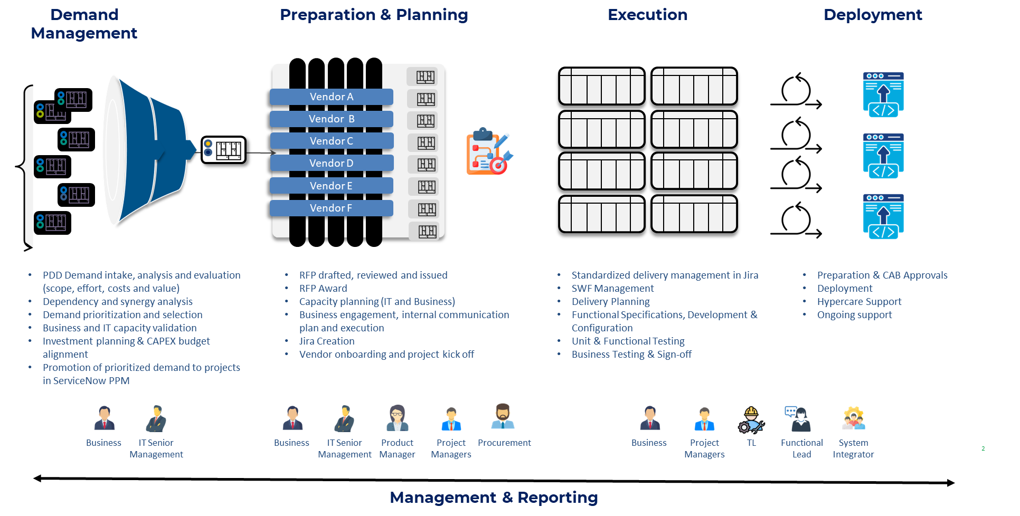
LIFECYCLE MODEL
PROPOSED LIFECYCLE MODEL
XXX
2

Slide 14
DEMAND MANAGEMENT
PREPARATION & PLANNING
EXECUTION
DEPLOYMENT
CAPABILITIES
CAPABILITIES
CAPABILITIES
CAPABILITIES
Demand intake channels (formal and informal)
Demand registration and logging
Channel consolidation level (single vs multiple entry points)
Standard intake formats or templates
Demand classification (type, size, urgency)
Differentiation between run, change, regulatory, and innovation demand
Business value definition
Availability of acceptance criteria
Technical feasibility input
Triage and initial validation activities
Demand routing and assignment
Handling of urgent or exception requests
Demand visibility and tracking
Identification of duplicate or overlapping demand
Demand consolidation and portfolio structuring
Demand prioritization mechanisms
Use of value, risk, and effort considerations
Portfolio backlog management
Roadmap definition (short / mid / long term)
Planning cycles (e.g., monthly, quarterly)
Effort estimation practices (high-level and detailed)
Capacity planning and forecasting
Alignment between demand and available capacity
Work allocation to teams / squads
Handling of unplanned or ad-hoc demand
Grouping and structuring of work (epics, features, initiatives)
Intake of work from prioritized backlog
Work breakdown (epics, stories, tasks)Sprint / iteration management
Work prioritization at team level
Definition of Ready (or equivalent readiness practices)
Definition of Done (or completion criteria)
Development and build practices
Testing practices (unit, integration, functional, UAT)
Defect management
Dependency management (intra- and inter-team)
Cross-team coordination
Work progress tracking and visibility
Documentation of functional and technical aspects
Release planning and scheduling
Release coordination across teams
Change management practices
Deployment execution (manual or automated)
Environment management (dev, test, prod)
Rollback and recovery capabilities
Validation and sign-off processes
Post-deployment verification
Hypercare and stabilization support
Transition to operations and support teams
ROLES
ROLES
ROLES
ROLES
Business requestors / stakeholders
Product or demand managers
Architects or technical reviewers
Product managers / product owners
Technical leads / architects
Business stakeholders
Delivery teams
Technical leads
Scrum masters / delivery managers
Product owners / business representatives
Release managers
Operations / support teams
Delivery teams (as contributors to release)
Business stakeholders (for validation / sign-off)
TOOLS
TOOLS
TOOLS
TOOLS
Demand capture tools Demand tracking and backlog tools
Communication channels Documentation tools for capturing request details
Reporting or visibility tools
Backlog and portfolio management tools
Road mapping and planning tools
Estimation and capacity planning tools
Reporting and visualization tools
Work management tools
Collaboration and communication tools
Documentation tools
Release and deployment tools
Monitoring and alerting tools
Incident and support management tools
GOVERNANCE
GOVERNANCE
GOVERNANCE
GOVERNANCE
Demand review forums
Decision-making practices for accepting, rejecting, or redirecting demand
Escalation mechanisms for urgent or conflicting requests
Definition of intake guidelines or policies
Alignment mechanisms with business stakeholders
Oversight of demand inflow and backlog health
Portfolio review forums
Prioritization and planning decision-making practices
Alignment mechanisms between business and technology
Definition of prioritization criteria and guidelines
Oversight of demand vs capacity balance
Decision practices for deferring or rejecting demand
Cross-area coordination mechanisms (if multiple OPCOs / domains)
Delivery review forums (e.g., sprint reviews, demos)
Issue and risk escalation practices
Oversight of delivery progress and performance
Definition of delivery standards and guidelines
Coordination mechanisms across teams or domains
Alignment with business during execution
Release and change approval forums (e.g., CAB or equivalents)
Decision-making practices for release readiness
Oversight of deployment risks and impacts
Definition of deployment and change policies
Coordination between delivery and operations
Control mechanisms for production changes
PERFORMANCE
PERFORMANCE
PERFORMANCE
PERFORMANCE
Demand volume and inflow trends
Demand quality (completeness, clarity)
Triage lead time% of demand entering through formal channels
% of urgent or bypassed requests
Demand duplication or overlap indicators
Visibility and traceability of demand status
Demand vs capacity visibility
Prioritization cycle time
% of demand planned vs unplanned
Alignment between planned and committed work
Planning predictability
Portfolio balance (e.g., run vs change vs regulatory)
Visibility of roadmap and planning outcomes
Velocity / throughput
Lead time and cycle time
Predictability (planned vs delivered)
Defect rates and quality indicators
Work in progress (WIP) levels
Dependency-related delays
Visibility of execution progress
Deployment success rate
Incidents and defects post-release
Time to recover from failures
Release frequency
Stability of deployed solutions
Effectiveness of hypercare period
Visibility of release outcomes

Slide 15
LIFECYCLE END-TO-END PROCESS
May 2026
Digital Products -
Lifecycle Model
03
Definition of the end-to-end product lifecycle, including demand typology, value-based prioritization, governance (RACI), and enabling tools
End-to-End Product Lifecyle
DEMAND MANAGEMENT
PREPARATION & PLANNING
EXECUTION
DEPLOYMENT
IT Business Solutions Delivery

Slide 16
LIFECYCLE MODEL – DEMAND MANAGEMENT
CORE PRINCIPLES
Four core practices that reshape the intake conversation
SINGLE FRONT DOOR FOR DEMAND
DEMAND SHAPING
CLASSIFICATION BY PRODUCT TYPE
LIGHTWEIGHT BUT FORMAL DISCOVERY
All demand types in one place
Structured problem-impact-value conversations
Two complementary axes
Required artifacts before scoring
• Enhancements
• Regulatory items
• Innovation initiatives
• Technical debt
• Large projects
• Incidents handled in IT Now only
• Don't accept 'solutions' directly
• Work with requesters to surface the underlying problem
• Quantify impact before discussing solution
• Apply value lens before scoping work
• Run · Grow · Transform (investment intent)
• Core SAP vs Extensions / satellites (architecture impact)
• Both axes captured at intake form
• Drives capacity allocation and routing
• Problem statement (clear description of the issue/opportunity)
• Users / personas impacted (who is affected and how)
• Hypothesis of value (owned by Business Requester / Product Manager)
Expected outcome (revenue, cost, CX, risk reduction)
Scope of impact (volume, OPCOs, processes)
• Hypothesis of risk (validated with Tech / Architect)
Technical complexity or dependencies
Delivery risks (integration, vendors, timelines)
Regulatory or operational constraints
Discovery feeds: Description (Funnel) · BV/UX scoring (Analyzing) · DoR check at Gate 1

Slide 17
LIFECYCLE MODEL – DEMAND MANAGEMENT
JIRA AS A SINGLE SOURCE OF TRUTH FOR DEMAND
Single intake form per Value Stream — every requester opens a Jira card with mandatory fields. The form auto-routes to the right Value Stream Team and applies a Class of Service.
INTAKE OF DEMAND FROM REQUESTORS
INITIAL CLASSIFICATION AND TRIAGE
01 · SOURCES
02 · INTAKE FORM (JIRA)
03 · MAIN VALUE STREAM
04 · VALUE STREAM TEAM
Who sends demand
Mandatory fields capture intent
End-to-end customer outcome
Auto-routed · 4 CS + 5 ITBA + 1 Enabling
BRS (UIL · CMP · NY)
JIRA REQUEST FORM
Meter & Device Operations
CUSTOMER SERVICES
Smart Metering · MDM · IS-U Device · 8760 EDI
CX & Digital CoE
▸ Value Stream destination
METER-2-CASH
Billing & Retail Operations
Data & Analytics
(routes the card)
METER → Meter & Device Operations
SAP ECC (FI/SD) · Streamserve · OpenText
▸ Demand type
BILL → Billing Operations
Revenue & Collections
Infrastructure
Production Support · Regulatory · Non-Regulatory
COLLECT → Revenue & Collections
SAP FICA · SOVOS Taxware · Payment · Dunning
▸ T-shirt size
SERVE → Customer Care & Engagement
Customer Care & Engagement
IA
S · M · L · XL
Foundation: SAP Basis · Gold Client · RPA · TOSCA
SAP CRM · Genesys · Nuance IVR · Medallia
▸ Class of Service
Enabling Team supports all 4 stages
OT
Standard · Fixed-date · Expedite · Intangible
Enabling Team — Foundation Services
▸ OPCO
SAP Basis · Gold Client · Blue Prism · TOSCA · Enable Now · Jira (no PM)
Procurement
UIL · CMP · NY · Iberdrola · Cross
Field Operations
Regulatory
▸ Business value statement
GIS · Workforce · OSG
Who benefits and how
Engineering & Asset Mgmt
Corporate Areas
▸ Sponsor
IT BUSINESS APPLICATIONS
Maintenance · Engineering
(approves at intake)
Carlos Garbin · 5 DVS
Network Operations & Control
P&T (G&E· Global SAP)
▸ Pain Score inputs
SCADA · EMS · OMS
ITBA: BV·UX·Safety·Effort · CS: BV·UX·Effort (no Safety)
GIS
Corporate & Regulatory
IT Now is reserved for incidents only — not for new demand.
FI · HR · Procurement · Reg.
Iberdrola Corp Services
Global SAP · Corp. Apps
Roles: Business Requester + Domain Product Manager
Roles: Domain Product Manager + Architect
Roles: Domain Product Manager + Architect
Roles
Roles
Roles

Slide 18
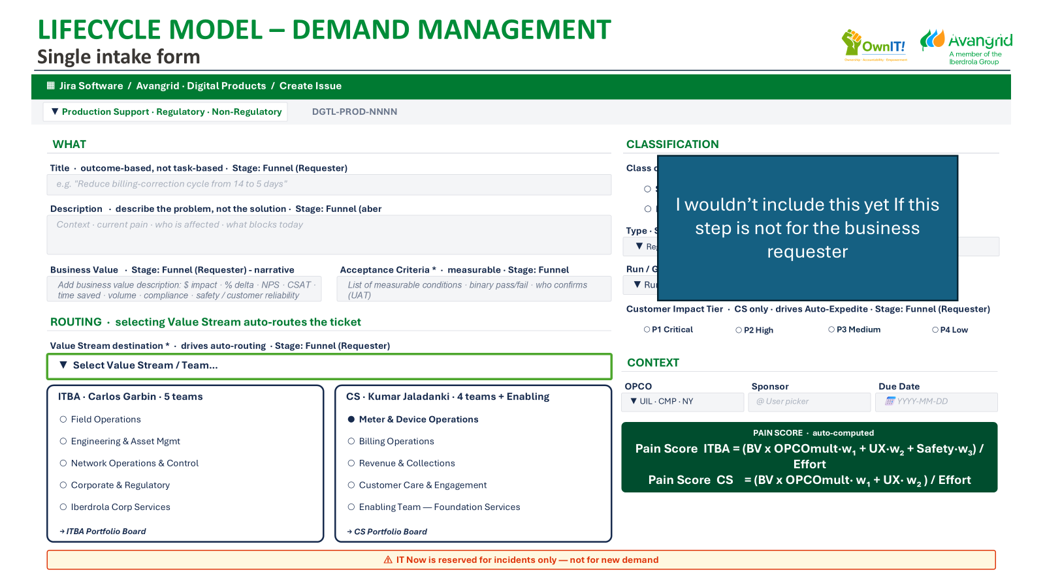
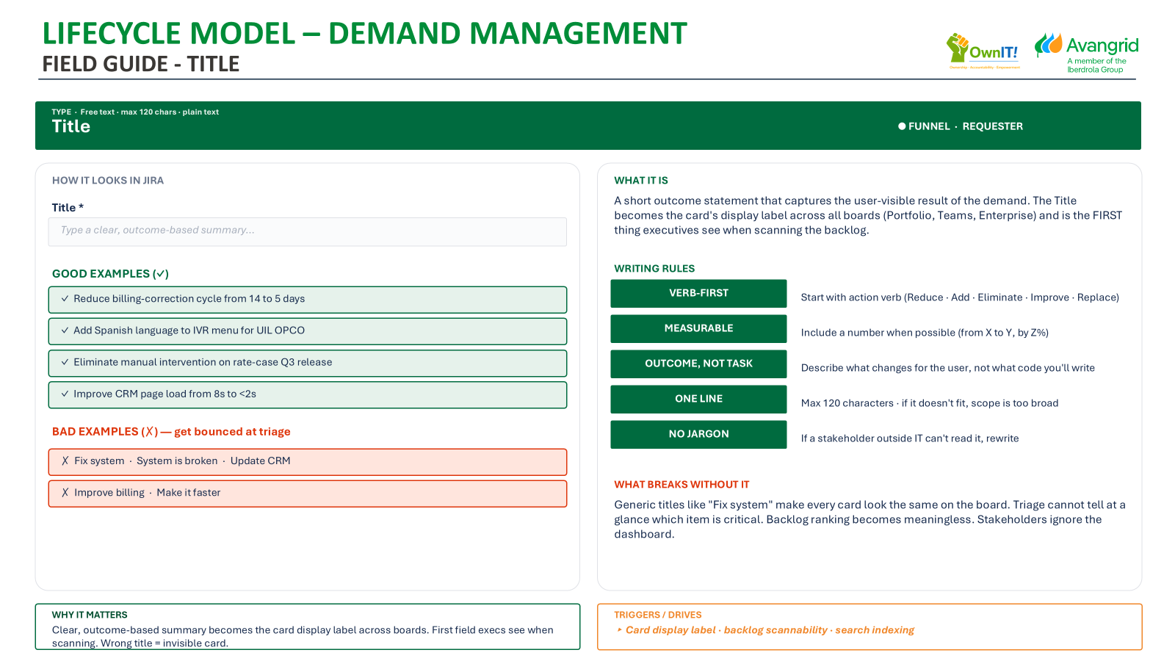
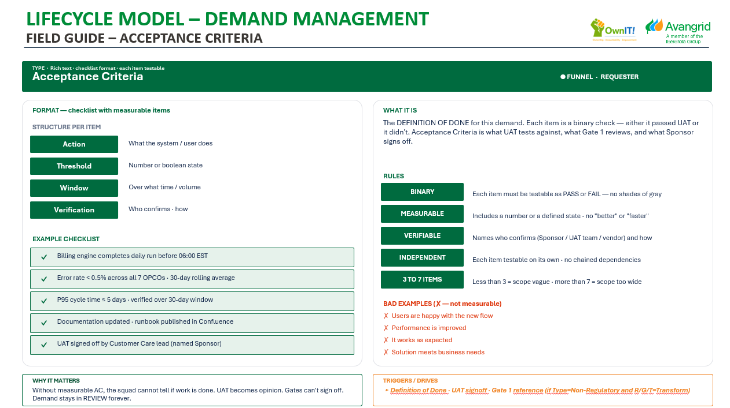

LIFECYCLE MODEL – DEMAND MANAGEMENT
INTAKE OF DEMAND FROM REQUESTORS
OBJECTIVE
Formalize a piece of work so it can be visualized, prioritized, tracked, and continuously improved within a controlled flow system.
PARTICIPANTS
Business Requester
Domain Product Manager
PROCESS
ARTIFACTS
Business Requester creates a ticket using Intake template
  JIRA: For new demand
Business Requester fill mandatory fields:
  Title (clear, outcome-based)
  Description (problem, not solution)
  Demand Type: Regulatory / Non-regulatory
  Business value (why it matters, narrative: $ impact, % delta, Time saved, Volume, Compliance, Safety.)
  Acceptance criteria (what success looks like / Definition of Ready: Action, Threshold, Window & Verification)
  Budget: (Yes/No)
  Requested due date (if applicable)
  Value Stream Definition
3. The Domain Product Manager take ownership of the ticket with this:
  Ticket Criteria:
  Fully filled
  No missing mandatory fields
  Clear business context provided
JIRA Ticket
Acceptance Criteria
Tools

Slide 19
LIFECYCLE MODEL – DEMAND MANAGEMENT
INTAKE OF DEMAND FROM REQUESTORS: Single intake form
Single intake form per Value Stream — every requester opens a Jira card with mandatory fields. The form auto-routes to the right Value Stream Team and applies a Class of Service.
▦ Jira Software / Avangrid · Digital Products / Create Issue
Demand
DGTL-PROD-NNNN
WHAT
CLASSIFICATION
Title · outcome-based, not task-based · Stage: Funnel (Requester)
Class of Service · swimlane assignment · PM (initial guess)
e.g. "Reduce billing-correction cycle from 14 to 5 days"
○ Standard
○ Fixed-Date
Description · describe the problem, not the solution · Stage: Funnel (aber
○ Expedite
○ Intangible
Context · current pain · who is affected · what blocks today
Demand Type:
Size · Stage: Reviewing (PM)
▼ Regulatory · Produc Sup · Non-Reg
▼ S · M · L · XL
Business Value · Stage: Funnel (Requester) - narrative
Acceptance Criteria * · measurable · Stage: Funnel (Requester)
Run / Grow / Transform · Stage: Reviewing (PM)
Add business value description: $ impact · % delta · NPS · CSAT · time saved · volume · compliance · safety / customer reliability
List of measurable conditions · binary pass/fail · who confirms (UAT)
▼ Run · Grow · Transform
ROUTING · selecting Value Stream auto-routes the ticket
Customer Impact Tier · CS only · drives Auto-Expedite · Stage: Funnel (Requester)
○ P1 Critical
○ P2 High
○ P3 Medium
○ P4 Low
Value Stream destination * · drives auto-routing · Stage: Funnel (Requester)
▼ Select Value Stream / Team…
CONTEXT
ITBA · Carlos Garbin · 5 teams
CS · Kumar Jaladanki · 4 teams + Enabling
OPCO
Sponsor
Due Date
▼ UIL · CMP · NY
@ User picker
📅 YYYY-MM-DD
○ Field Operations
● Meter & Device Operations
○ Engineering & Asset Mgmt
○ Billing Operations
Budget
▼ Yes / No
○ Network Operations & Control
○ Revenue & Collections
○ Corporate & Regulatory
○ Customer Care & Engagement
PAIN SCORE · auto-computed
Pain Score ITBA = (BV x OPCOmult·w₁ + UX·w₂ + Safety·w₃) / Effort
Pain Score CS = (BV x OPCOmult· w₁ + UX· w₂ ) / Effort
○ Iberdrola Corp Services
○ Enabling Team — Foundation Services
→ ITBA Portfolio Board
→ CS Portfolio Board
⚠ IT Now is reserved for incidents only — not for new demand

Slide 20
LIFECYCLE MODEL – DEMAND MANAGEMENT
INTAKE OF DEMAND FROM REQUESTORS: Field guide - title
TYPE · Free text · max 120 chars · plain text
Title
● FUNNEL · REQUESTER
HOW IT LOOKS IN JIRA
WHAT IT IS
Title *
A short outcome statement that captures the user-visible result of the demand. The Title becomes the card's display label across all boards (Portfolio, Teams, Enterprise) and is the FIRST thing executives see when scanning the backlog.
Type a clear, outcome-based summary…
GOOD EXAMPLES (✓)
WRITING RULES
✓ Reduce billing-correction cycle from 14 to 5 days
VERB-FIRST
Start with action verb (Reduce · Add · Eliminate · Improve · Replace)
✓ Add Spanish language to IVR menu for UIL OPCO
MEASURABLE
Include a number when possible (from X to Y, by Z%)
✓ Eliminate manual intervention on rate-case Q3 release
OUTCOME, NOT TASK
Describe what changes for the user, not what code you'll write
✓ Improve CRM page load from 8s to <2s
ONE LINE
Max 120 characters · if it doesn't fit, scope is too broad
BAD EXAMPLES (✗) — get bounced at triage
NO JARGON
If a stakeholder outside IT can't read it, rewrite
✗ Fix system · System is broken · Update CRM
✗ Improve billing · Make it faster
WHAT BREAKS WITHOUT IT
Generic titles like "Fix system" make every card look the same on the board. Triage cannot tell at a glance which item is critical. Backlog ranking becomes meaningless. Stakeholders ignore the dashboard.
WHY IT MATTERS
TRIGGERS / DRIVES
Clear, outcome-based summary becomes the card display label across boards. First field execs see when scanning. Wrong title = invisible card.
▸ Card display label · backlog scannability · search indexing

Slide 21
LIFECYCLE MODEL – DEMAND MANAGEMENT
INTAKE OF DEMAND FROM REQUESTORS: Field guide - description
TYPE · Rich text · min 100 chars · supports lists, links, mentions
Description
● FUNNEL · REQUESTER
STRUCTURE — 4 paragraphs
WHAT IT IS
CONTEXT
What is happening today · the as-is state · who does it · how often
Free-text narrative giving the triage team enough business context to understand the problem WITHOUT scheduling a meeting. Description is the difference between a TRIAGED ticket and a BOUNCED one.
Customer Care reps manually reconcile billing errors after each meter reading cycle (every 30 days, ~1,200 errors per cycle across 7 OPCOs).
GOLDEN RULE
Describe the PROBLEM · NOT the solution
CURRENT PAIN
What hurts · what risk · what waste
Each error takes 12 min to fix, totaling 240 hrs/cycle of manual labor. Customers wait 14 days for corrected bill — generates 8% of inbound complaints.
WHY THIS MATTERS
If you write "add a button to do X" the team is locked into your solution. If you write "users can't do X today, costing $Y/month" the team can engineer the cheapest path. Solutions belong in Acceptance Criteria, not Description.
WHO IS AFFECTED
Users · OPCOs · regulators · field crews
65 Customer Care agents (CR1) · 7 OPCOs (UIL, CMP, NY×3, RG&E×2) · all residential billing customers in error states.
GETS BOUNCED IF…
✗ Less than 100 characters
✗ No mention of who is affected
WHAT BLOCKS TODAY
Workarounds · manual steps · missing data
✗ No quantification (volume · frequency · impact)
No automated reconciliation between MDM and SAP FICA. Excel-based reports run twice daily by hand. Vendor SAP partner queue is 3 weeks deep.
✗ Reads as a feature request, not a problem statement
WHY IT MATTERS
TRIGGERS / DRIVES
Triage cannot validate DoR or compute Pain Score without business context. Description is the difference between TRIAGED and BOUNCED.
▸ Drives Triage decision · DoR validation · Pain Score component

Slide 22
LIFECYCLE MODEL – DEMAND MANAGEMENT
INTAKE OF DEMAND FROM REQUESTORS: Field guide – acceptance criteria
TYPE · Rich text · checklist format · each item testable
Acceptance Criteria
● FUNNEL · REQUESTER
FORMAT — checklist with measurable items
WHAT IT IS
STRUCTURE PER ITEM
The DEFINITION OF DONE for this demand. Each item is a binary check — either it passed UAT or it didn't. Acceptance Criteria is what UAT tests against, what Gate 1 reviews, and what Sponsor signs off.
Action
What the system / user does
Threshold
Number or boolean state
Window
RULES
Over what time / volume
BINARY
Each item must be testable as PASS or FAIL — no shades of gray
Verification
Who confirms · how
MEASURABLE
Includes a number or a defined state · no "better" or "faster"
EXAMPLE CHECKLIST
VERIFIABLE
Names who confirms (Sponsor / UAT team / vendor) and how
✓
Billing engine completes daily run before 06:00 EST
INDEPENDENT
Each item testable on its own · no chained dependencies
✓
Error rate < 0.5% across all 7 OPCOs · 30-day rolling average
3 TO 7 ITEMS
Less than 3 = scope vague · more than 7 = scope too wide
✓
P95 cycle time ≤ 5 days · verified over 30-day window
BAD EXAMPLES (✗ — not measurable)
✓
Documentation updated · runbook published in Confluence
✗ Users are happy with the new flow
✗ Performance is improved
✓
UAT signed off by Customer Care lead (named Sponsor)
✗ It works as expected
✗ Solution meets business needs
WHY IT MATTERS
TRIGGERS / DRIVES
Without measurable AC, the squad cannot tell if work is done. UAT becomes opinion. Gates can't sign off. Demand stays in REVIEW forever.
▸ Definition of Done · UAT signoff · Gate 1 reference (if Type=Non-Regulatory and R/G/T=Transform)

Slide 23
LIFECYCLE MODEL – DEMAND MANAGEMENT
INTAKE OF DEMAND FROM REQUESTORS: Value stream definition
TYPE · Single-select dropdown · 10 options (5 ITBA + 4 CS + 1 Enabling Team)
Value Stream destination
● FUNNEL · REQUESTER
ITBA · IT Business Apps · Carlos Garbin · 5 teams
CS · Customer Services Apps · Kumar Jaladanki · 4 teams + Enabling
○
Field Operations
●
Meter & Device Operations
GIS · Workforce · OSG
Smart Metering · MDM · IS-U Device · 8760 EDI
Distribution / field crew systems
Capture every read · zero data loss
○
Engineering & Asset Mgmt
○
Billing & Retail Operations
Maintenance · Engineering
SAP ECC (FI/SD) · Streamserve · OpenText
Asset lifecycle · capital planning
Bill on time · every OPCO · every day
○
Network Operations & Control
○
Revenue & Collections
SCADA · EMS · OMS
SAP FICA · SOVOS Taxware · Payment
Real-time grid operations
Convert invoices into cash · comply
○
Corporate & Regulatory
○
Customer Care & Engagement
FI · HR · Procurement · Reg.
SAP CRM · Genesys · Nuance IVR · Medallia
Corporate functions · compliance
Resolve interactions on first contact
○
Iberdrola Corp Services
○
Enabling Team — Foundation Services
Global SAP · Corp Apps
Basis · Gold Client · Blue Prism · TOSCA · Jira (no PM)
Iberdrola Spain corporate
Shared services for the 4 DVS
→ ITBA Portfolio Board · Carlos owns
→ CS Portfolio Board · Kumar owns
WHY IT MATTERS
TRIGGERS / DRIVES
If Product Manager never gets notified so the Triage never happens.
@notify PM · sets squad swimlane · routes to portfolio board

Slide 24
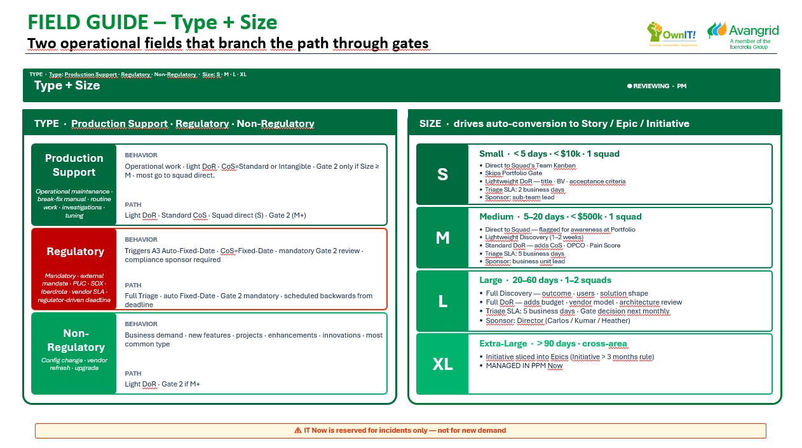
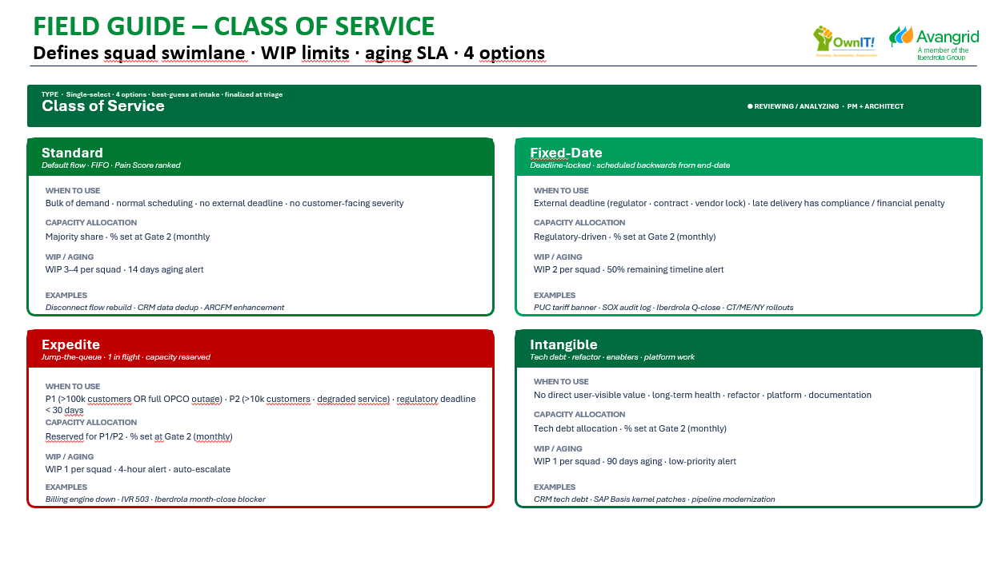
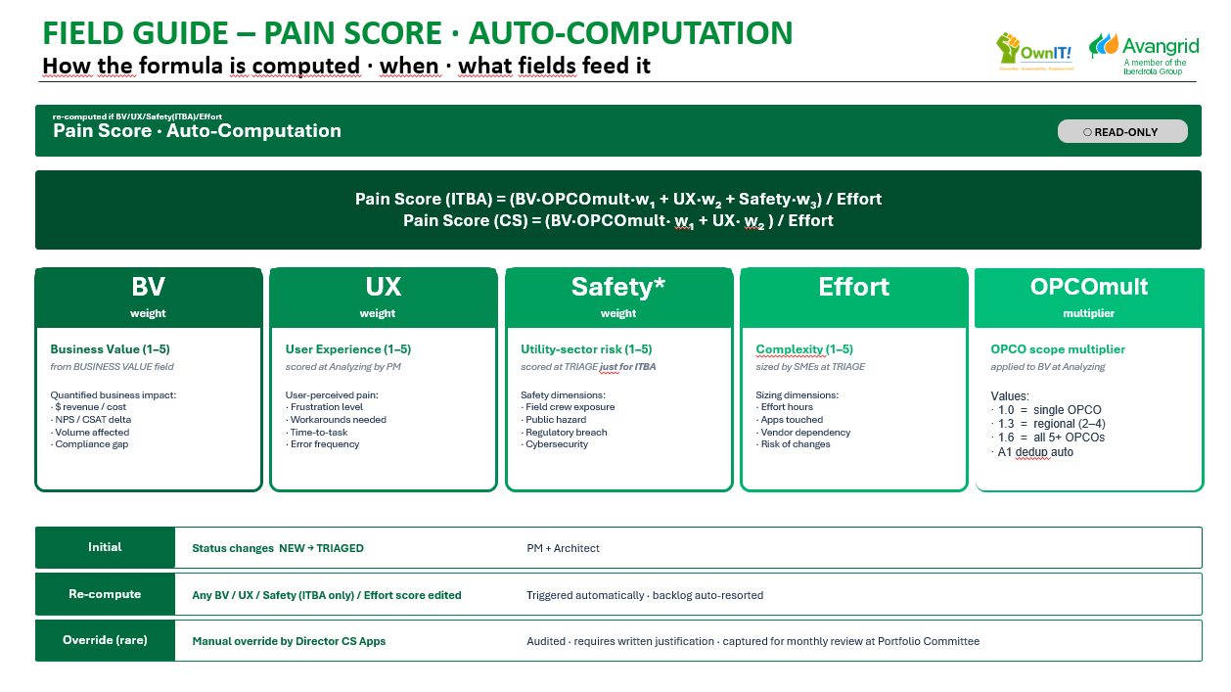
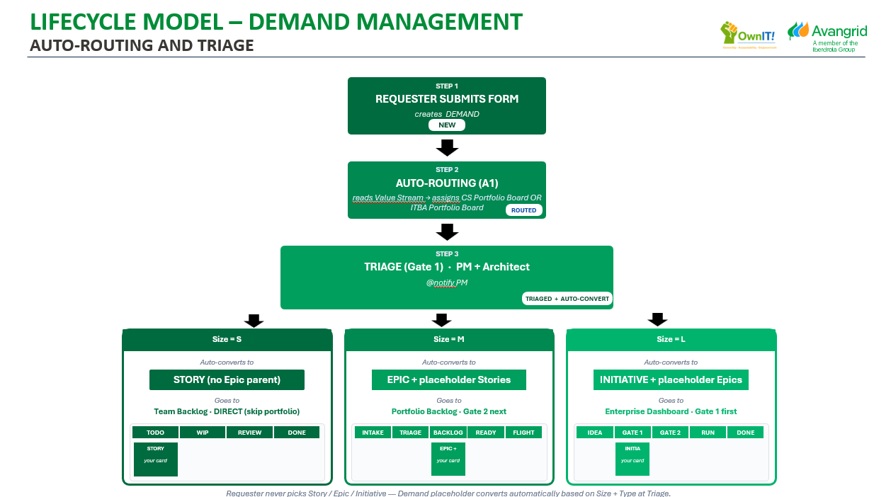
LIFECYCLE MODEL – DEMAND MANAGEMENT
INITIAL CLASSIFICATION AND TRIAGE
OBJECTIVE
Assess feasibility and quantify demand priority by consolidating business, technical, and operational inputs, generating a standardized Pain Score to enable objective portfolio decisions.
PARTICIPANTS
Domain Product Manager
Architect
Customer Services / Business Applications Managers
PROCESS
ARTIFACTS
PROCESS: REVIEWING
Product Manager validate and refine demand
  Is the business need clearly defined? Is it duplicate?
  Is value clearly defined?
Product Manager confirms and adjusts classification drivers
  Defines Demand Type (Production Support / Regulatory / Non-Regulatory)
  Defines Demand Size (S / M / L / XL) — drives level of analysis
  Validates Business value
Customer Services / Business Applications Managers:
  Defines Class of Service (Standard / Fixed-Date / Expedite / Intangible)
  Defines Safety Level (Business Applications only)
Architect + Product Manager assess effort and feasibility
  Validate architecture and integration impact
  Align on sizing and delivery considerations
System (Jira automation) computes Pain Score
  Inputs: BV, UX, Safety (ITBA only), Effort, OPCOmult
  Apply model:
    CS: (BV × OPCOmult × 0.40 + UX × 0.60) / Effort
    ITBA: (BV × OPCOmult × 0.45 + UX × 0.30 + Safety × 0.25) / Effort
  Score auto-calculates and ranks demand
Product Manager + Architect normalize and prepare demand for governance
  Lock final Size and Class of Service
  Ensure consistency (e.g., Regulatory → Fixed-Date)
  Complete demand card for portfolio review
Product Manager iniciate Autorouting & Triage
Demand Type & Demand Size
Class of Service
Pain Score auto-calculates &
ranks demand
Autorauting & Traige
Tools

Slide 25
LIFECYCLE MODEL – DEMAND MANAGEMENT
INTAKE OF DEMAND FROM REQUESTORS: Single intake form
Single intake form per Value Stream — every requester opens a Jira card with mandatory fields. The form auto-routes to the right Value Stream Team and applies a Class of Service.
▦ Jira Software / Avangrid · Digital Products / Create Issue
▼ Production Support · Regulatory · Non-Regulatory
DGTL-PROD-NNNN
CLASSIFICATION
Title · outcome-based, not task-based · Stage: Funnel (Requester)
Class of Service · swimlane assignment · PM (initial guess)
e.g. "Reduce billing-correction cycle from 14 to 5 days"
○ Standard
○ Fixed-Date
Description · describe the problem, not the solution · Stage: Funnel (aber
○ Expedite
○ Intangible
Context · current pain · who is affected · what blocks today
Regulatory:
Size · Stage: Reviewing (PM)
▼ Regulatory · Produc Sup · Non-Reg
▼ S · M · L · XL
Business Value · Stage: Funnel (Requester) - narrative
Acceptance Criteria * · measurable · Stage: Funnel (Requester)
Add business value description: $ impact · % delta · NPS · CSAT · time saved · volume · compliance · safety / customer reliability
List of measurable conditions · binary pass/fail · who confirms (UAT)
ROUTING · selecting Value Stream auto-routes the ticket
Value Stream destination * · drives auto-routing · Stage: Funnel (Requester)
▼ Select Value Stream / Team…
CONTEXT
ITBA · Carlos Garbin · 5 teams
CS · Kumar Jaladanki · 4 teams + Enabling
OPCO
Sponsor
Due Date
▼ UIL · CMP · NY
@ User picker
📅 YYYY-MM-DD
○ Field Operations
● Meter & Device Operations
○ Engineering & Asset Mgmt
○ Billing Operations
PAIN SCORE · auto-computed
Pain Score ITBA = (BV x OPCOmult·w₁ + UX·w₂ + Safety·w₃) / Effort
Pain Score CS = (BV x OPCOmult· w₁ + UX· w₂ ) / Effort
○ Network Operations & Control
○ Revenue & Collections
○ Corporate & Regulatory
○ Customer Care & Engagement
○ Iberdrola Corp Services
○ Enabling Team — Foundation Services
→ ITBA Portfolio Board
→ CS Portfolio Board
⚠ IT Now is reserved for incidents only — not for new demand

Slide 26
LIFECYCLE MODEL – DEMAND MANAGEMENT
ROUTING LOGIC BY SIZE
Small · < 1-3 months · < $10k · < 5 resources
Medium · 3-6 months · < $500k · < 10 resources
Large · >6 months · >$500k · >10 resources
Extra-Large · Multi-anual transformational projects with great resources
Size = S
Size = M
Size = L
Size = XL
AUTO-CONVERTS TO
AUTO-CONVERTS TO
AUTO-CONVERTS TO
AUTO-CONVERTS TO
Story (no Epic)
Epic + Stories
Initiative + Epics
Initiative + Epics
GOES TO
GOES TO
GOES TO
GOES TO
TEAM BACKLOG
DIRECT
PORTFOLIO BACKLOG
GATE 2
MANAGED in PPM Now
MANAGED in PPM Now
OPERATIONAL RULES BY SIZE
OPERATIONAL RULES BY SIZE
OPERATIONAL RULES BY SIZE
OPERATIONAL RULES BY SIZE
• Direct to Squad's Team Kanban
• Skips Portfolio Gate
• Lightweight DoR — title · BV · acceptance criteria
• Triage SLA: 2 business days
• Sponsor: sub-team lead
• Lightweight Discovery (1–2 weeks)
• Standard DoR — adds CoS · OPCO · Pain Score
• Triage SLA: 5 business days
• Sponsor: business unit lead
• Full Discovery — outcome · users · solution shape
• Full DoR — adds budget · vendor model · architecture review
• Triage SLA: 5 business days · Gate decision next monthly
• Sponsor: Director (
• MANAGED IN PPM Now
Skip portfolio · pulled by squad
Sequenced by Pain + CoS
Owns roadmap horizon · multi-quarter
Owns roadmap horizon · multi-quarter
ONE LOGIC · TWO LEVELS — why size dictates routing
CS vs ITBA · WHERE THE LOGIC DIFFERS
TEAM-LEVEL · Squad pulls by capacity
CS
1 OVS Meter-to-Cash · 4 teams + 1 Enabling · weights w₁=0.40 w₂=0.60 (no Safety) · Customer Reliability replaces Safety · OVS KPIs (NPS · CSAT · Reliability)
Size S items DON'T need cross-team coordination · go straight to Squad's Team Kanban after Triage. Squad pulls when WIP slot available.
ITBA
5 teams unchanged · weights w₁=0.45 w₂=0.30 w₃=0.25 (BV-heavy · safety relevant for grid systems) · PM· Carlos approves at Gate 2
PORTFOLIO-LEVEL · Director sequences
Size M/L touch capacity slots · multiple squads · vendor scope · need Gate 2 approval for ROI + capacity reservation.
BOTH
Same intake form · same A1–A6 automations · same Triage cadence · same Gate 2 cadence · same Class of Service taxonomy
Notes:
Operational Rules by Size

Slide 27
LIFECYCLE MODEL – DEMAND MANAGEMENT
INITIAL CLASSIFICATION AND TRIAGE: Class of service Process
01 OBSERVE
02 ASSESS
03 DECIDE
04 ADJUST
MEASURE flow per CoS
DETECT imbalances
REBALANCE proposed
APPLY new mix
Squad cycle-time + WIP + completion-rate per CoS lane · weekly snapshot
Are Expedites > planned cap? Fixed-Date items at risk? Standard starving? Aging tags rising?
PM propose adjustments for next quarter · Director endorses at Gate 2
WIP limits updated in Jira · automations re-tuned · KPIs re-baselined · loop back to OBSERVE
WHO OWNS WHAT · THE LOOP THAT NEVER STOPS
OBSERVE
Product Manager (Portfolio per VS) – Customer Services Applications Manager
Weekly · automated dashboard
ASSESS
Product Manager – Customer Services Applications Manager
Weekly · Triage meeting
DECIDE
Director at Gate 2 – IT Program Delivery
Monthly · Portfolio Committee
ADJUST
Squad Lead – IT Program Deliver
End of quarter · feeds quarterly priorities summary to existing P&T BRP / Digital CoE BRP
FOUR CoS LANES · ASSIGNMENT RULES · capacity % to be defined per quarter at Gate 2 (not committed yet)
Standard
Fixed-Date
Expedite
Intangible
default · no flag
Type = Regulatory → A3 auto
CIT P1/P2 → A2 auto
tech debt · opt-in by PM
Bulk of demand · ranked by Pain Score
External deadline · scheduled backwards
Customer outage · jump-the-queue
Refactor · platform · enablers

Slide 28
LIFECYCLE MODEL – DEMAND MANAGEMENT
INITIAL CLASSIFICATION AND TRIAGE: Class of Service Classification
TYPE · Single-select · 4 options · best-guess at intake · finalized at triage
Class of Service
● REVIEWING / ANALYZING · PM + ARCHITECT
Standard
Fixed-Date
Default flow · FIFO · Pain Score ranked
Deadline-locked · scheduled backwards from end-date
WHEN TO USE
WHEN TO USE
Bulk of demand · normal scheduling · no external deadline · no customer-facing severity
External deadline (regulator · contract · vendor lock) · late delivery has compliance / financial penalty
CAPACITY ALLOCATION
CAPACITY ALLOCATION
Majority share · % set at Gate 2 (monthly
Regulatory-driven · % set at Gate 2 (monthly)
WIP / AGING
WIP / AGING
WIP 3–4 per squad · 14 days aging alert
WIP 2 per squad · 50% remaining timeline alert
EXAMPLES
EXAMPLES
Disconnect flow rebuild · CRM data dedup · ARCFM enhancement
PUC tariff banner · SOX audit log · Iberdrola Q-close · CT/ME/NY rollouts
Expedite
Intangible
Jump-the-queue · 1 in flight · capacity reserved
Tech debt · refactor · enablers · platform work
WHEN TO USE
WHEN TO USE
P1 (>100k customers OR full OPCO outage) · P2 (>10k customers · degraded service) · regulatory deadline < 30 days
No direct user-visible value · long-term health · refactor · platform · documentation
CAPACITY ALLOCATION
CAPACITY ALLOCATION
Reserved for P1/P2 · % set at Gate 2 (monthly)
Tech debt allocation · % set at Gate 2 (monthly)
WIP / AGING
WIP / AGING
WIP 1 per squad · 4-hour alert · auto-escalate
WIP 1 per squad · 90 days aging · low-priority alert
EXAMPLES
EXAMPLES
Billing engine down · IVR 503 · Iberdrola month-close blocker
CRM tech debt · SAP Basis kernel patches · pipeline modernization

Slide 29
LIFECYCLE MODEL – DEMAND MANAGEMENT
INITIAL CLASSIFICATION AND TRIAGE: Pain score Model
re-computed if BV/UX/Safety(ITBA)/Effort
Pain Score · Auto-Computation
○ READ-ONLY
BV
UX
Safety*
Effort
OPCOmult
weight
weight
weight
multiplier
Business Value (1–5)
User Experience (1–5)
Utility-sector risk (1–5)
Complexity (1–5)
OPCO scope multiplier
from BUSINESS VALUE field
scored at Analyzing by PM
scored at TRIAGE just for ITBA
sized by Architec & Customer Services Applications Managers at TRIAGE
applied to BV at Analyzing
Quantified business impact:
· $ revenue / cost
· NPS / CSAT delta
· Volume affected
· Compliance gap
User-perceived pain:
· Frustration level
· Workarounds needed
· Time-to-task
· Error frequency
Safety dimensions:
· Field crew exposure
· Public hazard
· Regulatory breach
· Cybersecurity
Sizing dimensions:
· Effort hours
· Apps touched
· Vendor dependency
· Risk of changes
Values:
· Single OPCO
· Regional (2–4)
· All / 5+ OPCOs
-
-
-
-
-
1
Minimal impact · no measurable business outcome
1
No noticeable impact
1
No safety or compliance risk
1
Very low · small change · single system
1
Single OpCo
impact
impact
impact
impact
impact
2
Local improvement · limited scope or impact
2
Minor inconvenience · occasional friction
2
Low risk · internal exposure only
2
Low · limited scope
3
Clear business benefit · efficiency or cost reduction
3
Recurrent friction · workarounds required
3
Moderate risk · potential compliance issue
3
Medium · moderate integration
2
Regional (2-4 OpCos)
4
High functional impact · significant cost, revenue or CX improvement
4
High frustration · major productivity or CX impact
4
High risk · field crew or public exposure
4
High · multiple systems · vendor dependency
+
3
All / 5+ OpCos
5
Enterprise / regulatory impact · major revenue or cost driver
+
5
High frustration · major productivity or CX impact
+
5
Critical risk · regulatory breach or safety incident
+
5
Very high · cross-domain · high uncertainty
+
Initial
Status changes NEW → TRIAGED
PM + Architect
Re-compute
Any BV / UX / Safety (ITBA only) / Effort score edited
Triggered automatically · backlog auto-resorted
Override (rare)
Manual override by Director CS Apps
Audited · requires written justification · captured for monthly review at Portfolio Committee
* Only aplicable for IT Business Applications

Slide 30
LIFECYCLE MODEL – DEMAND MANAGEMENT
INITIAL CLASSIFICATION AND TRIAGE: Pain score origin
JAvi
TYPE · Numeric · auto-computed at TRIAGED status · read-only
Pain Score · Origin · Two variants: CS + ITBA
○ READ-ONLY
✓ Auto-computed removes politics · Champion can't game ranking
✓ Auto-computed removes politics · Champion can't game ranking
DIGITAL PRODUCTS · VARIANT · CS
DIGITAL PRODUCTS · VARIANT · ITBA
CS: 2 components (BV+UX · UX-heavy)
ITBA: 3 components (BV+UX+Safety · BV-heavy)
CS: Pain Score = (BV·OPCOmult·0.40 + UX·0.60) / Effort
ITBA: Pain Score = (BV·OPCOmult·0.45 + UX·0.30 + Safety·0.25) / Effort
WHY DIFFERENT WEIGHTS PER VS · CS=customer-first
WHY DIFFERENT WEIGHTS PER VS · ITBA=grid-first
BV · CS 0.40 / ITBA 0.45
Quantified business impact
BV
Quantified business impact
absorbs Frequency + Time Lost + Cost
absorbs Frequency + Time Lost + Cost
UX · CS 0.60 / ITBA 0.30
CS is customer-facing — UX wins
UX
CS is customer-facing — UX wins
absorbs Frustration + Customer Experience
absorbs Frustration + Customer Experience
Effort
Forces ROI thinking · high-effort low-value sinks
Safety
Field crew · public · regulatory
moves to denominator
applies only to ITBA
OPCOmult
Business impact
Effort
Forces ROI thinking · high-effort low-value sinks
moves to value and impact
moves to denominator
OPCOmult
Business impact
moves to value and impact
WHY IT MAKES SENSE FOR AVANGRID
✓ UX-heavy reflects CS strategy (customer-first)
✓ Utility-calibrated · Safety isolated · not buried in BV
✓ Comparable cross-VS · 4 DVS share same formula
Auto-computed removes politics · Reviewers can't game ranking

Slide 31
LIFECYCLE MODEL – DEMAND MANAGEMENT
INITIAL CLASSIFICATION AND TRIAGE: Auto-routing and triage
STEP 1
REQUESTER SUBMITS FORM
creates DEMAND
NEW
STEP 2
AUTO-ROUTING (A1)
reads Value Stream → assigns CS Portfolio Board OR ITBA Portfolio Board
ROUTED
STEP 3
TRIAGE (Gate 1) · PM + Architect
@notify PM
TRIAGED + AUTO-CONVERT
Size = S
Size = M
Size = L
Size = XL
Auto-converts to
Auto-converts to
Auto-converts to
Needs review before converting to:
STORY (no Epic parent)
EPIC + placeholder Stories
INITIATIVE + placeholder Epics
INITIATIVE + placeholder Epics
Goes to
Goes to
Goes to
Goes to
Team Backlog · DIRECT (skip portfolio)
Portfolio Backlog · Gate 2 next
Portfolio Backlog · Gate 2 next
Portfolio Backlog · Gate 2 next
TODO
WIP
REVIEW
DONE
INTAKE
TRIAGE
BACKLOG
READY
FLIGHT
IDEA
GATE 1
GATE 2
RUN
DONE
STORY
EPIC +
INITIA
your card
your card
your card
Requester never picks Story / Epic / Initiative — Demand placeholder converts automatically based on Size + Type at Triage.

Slide 32
LIFECYCLE MODEL – DEMAND MANAGEMENT
INITIAL CLASSIFICATION AND TRIAGE: Automation Catalog
NTT DATA
ID
NAME
TRIGGER
ACTION
FIELDS AFFECTED
OWNER
A1
Auto-Routing
Demand submitted via Jira intake form
Value Stream · OPCO · Status (NEW → ROUTED)
Reads Value Stream + OPCO → routes ticket to correct Portfolio Board · @notifies PM
PM
A2
Auto-Expedite
Customer Impact Tier = P1 (or P2 critical)
Sets CoS = Expedite · forces WIP-1 on squad · emails Director + Sponsor
Class of Service · WIP lane
PM
A3
Auto-Fixed-Date
Type = Regulatory
Sets CoS = Fixed-Date · forces a due date · pre-flags Gate 2 priority
Class of Service · Due Date
PM
A4
Auto-Pain-Score
BV · UX · (Safety: ITBA only) · Effort · filled at Analyzing
Computes Pain Score
· ITBA: (BV·OPCOmult·w₁+UX·w₂+Safety·w₃)/E
· CS: (BV·OPCOmult·0.40+UX·0.60)/E · writes Pain Score
Pain Score (read-only · system field)
PM
A5
Auto-Convert
At Triage (Gate 1) when Demand has Size + Type set
Issue Type · Parent Link · Status (TRIAGED)
Converts Demand placeholder: S → Story · M → Epic · L → Initiative · (Incidents handled in IT Now only) → Bug
PM
A6
Aging Alert
Daily — flags any card stuck past CoS-defined SLA
@notifies owner · adds AGING tag · raises a flow blocker on squad board
Aging tag · Flow Blocker
Squad Lead
READ THIS WITH THE AFTER-SUBMISSION SLIDE
A1 fires at submit · A2/A3 fire when intake flags trip · A4 + A5 fire at Triage · A6 runs daily across the entire portfolio. Together they shorten ideation-to-delivery cycle by ~40 % and cut handoff delays.

Slide 33
LIFECYCLE MODEL – DEMAND MANAGEMENT
GOVERNANCE: Governance gates
Example · Customer Services Portfolio Board · Governance gates marked in red
▲ GATE 1 · TRIAGE · weekly
▲ GATE 2 · PORTFOLIO · monthly
Funnel
Reviewing
Analyzing
Backlog
Implementing
Done
DESCRIPTION
DESCRIPTION
DESCRIPTION
DESCRIPTION
DESCRIPTION
DESCRIPTION
Idea submitted with problem statement
Business case refined · classification applied
Sized · scored · feasibility checked
Approved · awaiting capacity
Assigned to Value Stream Team
Value realized · post-implementation review
OWNER
OWNER
OWNER
OWNER
OWNER
OWNER
Sponsor
Sponsor + PM
PM + Architect
Portfolio Manager
Team PM
Sponsor + PM
REVIEWER
SLA
OUTPUT
SEQUENCING
TRACKED AT
OUTPUT
PM
2 weeks
Pain Score · T-shirt effort · Class of Service
by Class of Service + Pain Score
Layer 0 VP Dashboard
Outcome metrics captured
INPUT
OUTPUT
ARTIFACT
STATUS
FLOW
FEEDBACK
Demand placeholder · Title · Description · BV
Refined business case · CoS guess
Discovery Report · Concept Prototype
Ready For Execution
Pulled into Squad Kanban (Phases 0–4)
Lessons learned
Only S demands BYPASS this board — they enter the Squad's Team Kanban directly. M / L / XL Initiatives flow through the Portfolio Board (Gate 2 approval required).

Slide 34
LIFECYCLE MODEL – DEMAND MANAGEMENT
GOVERNANCE: Gates deep dive
GATE 1 · TRIAGE
GATE 2 · PORTFOLIO COMMITTEE
Quality gate · entry validation · DoR check
Investment gate · Go/No-Go · capacity slot
▸ WEEKLY · 30 min
▸ MONTHLY · 90 min
PURPOSE
PURPOSE
Confirms incoming Demand has enough business context to be worked on. Filters noise · prevents wasted analysis effort downstream.
Approves investment · slots capacity · re-ranks portfolio backlog by Pain Score + CoS. The gate where Initiatives become committed work.
WHO PARTICIPATES
WHO PARTICIPATES
▸ CHAIR · Lead PM (rotating among VS PMs)
▸ ATTENDEES · PMs (one per VS) · Architect · Customer Services Applications Managers · Business Applications Managers
▸ OBSERVERS · Sponsor on request
▸ CHAIR · VP (Vitor Cruz)
▸ DECIDERS · Directors — Carlos Garbin (ITBA) · Kumar Jaladanki (CS) · Heather LaJoie (CS)
▸ ATTENDEES · PMs (per VS) · Architect · IT Program Delivery Manager
▸ OBSERVERS · Sponsors · Customer Services Applications Managers · Business Applications Managers
(on relevant items only)
WHEN
WHEN
Every Wednesday 09:00–09:30 ET · standing meeting · cancelled only if zero new Demands
First Tuesday of the month · 13:00–14:30 ET · pre-read circulated 3 business days ahead
HOW · STEP-BY-STEP
HOW · STEP-BY-STEP
1. Lead PM pulls all NEW + ROUTED tickets from prior 7 days
2. For each: validate DoR (Title · Description · BV narrative · AC · VS · OPCO · Sponsor)
3. Decision · ACCEPT (→ Reviewing) · BOUNCE (→ Requestor with reason) · MERGE (→ existing item)
4. Auto-routing recorded in Jira · @notify PM of accepted items
5. KPI captured · DoR pass rate · bounce rate · channel adoption
1. Pre-read · all Initiatives in ANALYZING with Pain Score + Discovery Report attached
2. Walk-through by Pain Score (highest first) · Architect comments on feasibility
3. Decision per Initiative · GO · NO-GO · DEFER
4. Backlog re-ranked by CoS + Pain Score · capacity heat-map updated
5. Decisions logged in Jira · @notify Sponsors + Squad Leads
INPUTS / OUTPUTS
INPUTS / OUTPUTS
INPUTS · NEW + ROUTED tickets · DoR checklist · Value Stream policies
OUTPUTS · TRIAGED · BOUNCED · merge links · weekly KPI report
INPUTS · TRIAGED Initiatives · Pain Scores · Discovery Reports · capacity per VS · vendor pipeline
OUTPUTS · Ready For Execution · capacity slot · Backlog rank · OVS KPI panel updated (NPS · CSAT · Reliability · cycle time)

Slide 35
LIFECYCLE MODEL – DEMAND MANAGEMENT
GOVERNANCE: Post-gate 2 (go / no-go / defer)
GATE 2 · DECISION
Director (Carlos · Kumar · Heather)
Monthly · 90 min
GO
NO-GO
DEFER
Initiative approved
Initiative rejected
Decision postponed
01 STATUS
01 STATUS
01 STATUS
Issue → 'Ready For Execution' · capacity slot reserved · Backlog rank assigned
Issue → 'Rejected' · removed from active backlog · archived for traceability
Issue → 'Deferred' · stays in portfolio backlog · timestamp + reason captured
02 NOTIFY
02 RATIONALE
02 REASON
@Sponsor + @Squad Lead · Layer 0 VP Dashboard updated · published in Confluence
Director records reason: capacity · ROI · strategic fit · technical feasibility
Insufficient info · capacity tight · waiting on dependency · seasonal timing
03 HANDOFF
03 NOTIFY
03 NOTIFY
PM (Portfolio) hands off to Tech Lead + squad · DoR re-checked at squad level
@Sponsor receives written rationale · Confluence post · learning captured
@Sponsor + @PM · expected return date communicated
04 EXECUTION
04 RE-SUBMIT
04 RE-EVALUATE
Enters Team Kanban · Phase 0 Discovery → Phase 1 Materialization → Phase 2 Creation → Phase 3 Ongoing → Phase 4 Maintenance
Sponsor may re-submit with different framing/scope · counts as new Demand · full Triage
Auto-surfaces at next monthly Gate 2 · PM may add missing info between gates
05 KPIs
05 LEARNING
05 ESCALATION
Cycle time · throughput · quality · NPS/CSAT delta · OVS KPI panel monitors outcomes
Quarterly review of NO-GO patterns to refine intake quality + scoring rubrics
If deferred 3+ times → escalate to BRP for cross-portfolio decision
All Gate 2 decisions are LOGGED in Jira · auditable · feed quarterly portfolio review at the BRPs (P&T + Digital CoE)

Slide 36
LIFECYCLE MODEL – DEMAND MANAGEMENT
GOVERNANCE: Post-gate 2 (go / no-go / defer)
LEVEL 1 · PORTFOLIO PRACTICES
LEVEL 2 · VALUE STREAM PLANNING
Director-level · quarterly horizon · cross-VS planning
PM-level · post-Gate 2 GO · per Initiative within the Value Stream
OWNER · Directors Customer Services Applications Managers · Business Applications Managers
· cadence: monthly Gate 2
OWNER · PM (Portfolio · per VS) · cadence: per Initiative · continuous within Value Stream
CAPACITY PLANNING
KICK-OFF
Squad capacity per quarter · % allocation per CoS · Standard / Fixed-Date / Expedite / Intangible mix · validated at Gate 2 monthly
Within 1 week of Gate 2 GO · PM + Tech Lead + Sponsor · scope confirmed · success metrics agreed within Product context
PORTFOLIO BACKLOG
DEEP DISCOVERY
Long-term roadmap · ranked by Pain Score + CoS + OPCO multiplier · re-ranked at every Gate 2
Phase 0 deepens · users / personas validated · solution shape · risks · architecture review (run by domain product team / vendor · NOT Digital Products)
APPLICATION LICENSES
SIZING & MATERIALIZATION
License inventory · renewal calendar · cost optimization · vendor management · auto-flagged at intake
Phase 1 · t-shirt confirmed · roadmap · budget · vendor model finalized · feeds Product roadmap of the VS
CROSS-VS DEPENDENCIES
DEFINITION OF READY
Mapped at quarterly BRP · feeds capacity decisions · resolved before Gate 2 commits
Squad-level DoR check before pulling to Phase 2/3 (Delivery · Digital Products) · DoR mismatch → back to Materialization
KPIs ALIGNMENT
EXISTING INITIATIVES
Operational KPIs drive prioritization, capacity allocation, and continuous re-ranking at Gate 2
Scope-add via 'Demand on Existing Initiative' shortcut · Squad PM evaluates impact · sub-task linked to parent Initiative

Slide 37
LIFECYCLE MODEL – DEMAND MANAGEMENT
GOVERNANCE: Demand on existing initiative
WHEN · Initiative is in IMPLEMENTING · new related ask comes from same Sponsor / OPCO / business area
EXAMPLE · CRM unified-record Initiative live · Sponsor asks to add 'phone number masking for CCAR call recordings'
01
02
03
04
LINK
BYPASS
SQUAD APPROVE
STORY
Requester opens NEW Demand · types Parent Initiative key · A1 detects link
Skips Funnel · Reviewing · Analyzing · Gate 2 — already approved as part of parent
Squad PM accepts (or rejects) the scope-add — protects WIP and timeline
Becomes a STORY under the parent Initiative's Epic · pulled into Squad Team Kanban
Form auto-fills VS · OPCO · Sponsor from parent
No Pain Score recompute · keeps parent's CoS
PM evaluates impact · estimates delta · raises if blocking
Story status syncs with parent Initiative · cycle-time tracked separately
DECISION MATRIX · When each path applies based on parent Initiative status
Funnel / Reviewing / Analyzing
Update the EXISTING Demand card directly (not yet committed) · no new card needed
Backlog (post-Gate 2 GO · awaiting capacity)
Update parent Initiative scope · re-evaluate at next Gate 2 if scope grows
Implementing (active in squad)
USE SHORTCUT (this slide) → Story under existing Epic · Squad PM approves
Done (completed)
Open NEW Demand through Funnel · normal flow · may become new Initiative
GUARDRAILS · EVEN WHEN PARENT IS IMPLEMENTING, SHORTCUT MAY BE REJECTED
▸ Scope > 5 days OR > 1 squad sprint → open new Demand through Funnel ▸ Different Sponsor / OPCO / VS than parent → normal flow
▸ Squad PM has full authority to reject if WIP / timeline at risk · Sponsor escalates to Director if needed

Slide 38
LIFECYCLE MODEL – DEMAND MANAGEMENT
GOVERNANCE: Quarterly Review
WHAT
WHY
WHEN
WHO
Digital Products does NOT run its own BRP · injects quarterly priorities summary into the existing P&T BRP and Digital CoE BRP.
Avoids creating a parallel ritual · respects governance already in place · ensures cross-portfolio alignment without overhead.
Aligned to existing P&T BRP cadence · quarterly priorities summary prepared 1 week before each event · no own meeting on Digital Products calendar.
Digital Products contributes KPI-driven performance insights into existing BRPs.
Directors own Value Stream performance (capacity, delivery, and service KPIs).
Product Managers and Architects provide demand, prioritization (Pain Score), and feasibility inputs.
ACT 1
ACT 2
ACT 3
ACT 4
CONFIRM WHY
ALIGN HOW
SPOT DEPS
LOCK KPIS
▸ 30 min
▸ 90 min
▸ 60 min
▸ 60 min
VP reviews corporate OKRs and quarterly direction.
Each PM presents top-3 Initiatives + dependencies.
Wall mapping — cross-VS dependencies surfaced and resolved.
Capacity allocation + KPI targets agreed and endorsed
OUTPUTS
OUTPUTS
OUTPUTS
OUTPUTS
▪ Strategic priorities recap
▪ Top-3 Initiatives per VS
▪ Cross-VS dependency map
▪ KPI targets locked
▪ Constraints / non-negotiables
▪ Capacity asks per VS
▪ Owners agreed per arrow
▪ Prioritized backlog aligned to capacity and Pain Score
▪ Risks · assumptions called out
▪ Sequencing locked per quarter
▪ Escalation list for constraints and risks
INPUTS
OUTPUTS
RHYTHM
Outputs of Gate 2 sessions of the quarter · Pain Score rankings · Capacity heat-map per VS · Corporate OKR cascade
Quarterly OKRs locked · OVS KPI deltas reviewed (NPS · CSAT · Reliability · cycle time) · Cross-VS dependency map · Capacity commitments per VS
Q1 · Q2 · Q3 · Q4 — first week of each quarter · outputs reviewed at the next month's Gate 2

Slide 39
LIFECYCLE MODEL – DEMAND MANAGEMENT
PERFORMANCE METRICS
A standardized KPI framework to monitor demand intake quality, flow efficiency, and adoption, enabling early detection of bottlenecks and continuous improvement.
DEMAND VOLUME
DoR PASS RATE
TRIAGE LEAD TIME
CHANNEL ADOPTION
Submissions / week
% accepted at first submit
Submit → Gate 1 verdict
% via single front door
trend visible
≥ 70 %
≤ 5 d (P50)
≥ 90 %
by VS · CoS · OPCO
Target ≥ 70 %
Target ≤ 5 business days
Target 90 % by month 6
EXPEDITE SHARE
DUPLICATION RATE
STATUS VISIBILITY
% of throughput
% submissions matched
% with live status
≤ 20 %
↓
100 %
Cap 20 %
Trend: down
Target 100 %
TAKEAWAY
These seven KPIs are the contract — if any one drifts, the demand funnel is leaking. Live dashboard means leakage is visible the next day, not the next quarter.
Notes:
Previous definition: 15 days (pending if business or calendar). For production Support it’s currently triaged at the same day. For critical it’s looked at the same day.
For critical ítems include a single day Review.

Slide 40
LIFECYCLE END-TO-END PROCESS
May 2026
Digital Products -
Lifecycle Model
03
Definition of the end-to-end product lifecycle, including demand typology, value-based prioritization, governance (RACI), and enabling tools
End-to-End Product Lifecyle
DEMAND MANAGEMENT
PREPARATION & PLANNING
EXECUTION
DEPLOYMENT
IT Business Solutions Delivery

Slide 41
LIFECYCLE MODEL
BASE FRAMEWORK FOR THE LIFECYCLE MODEL
The lifecycle model establishes a structured end-to-end framework to manage demand from intake through planning, execution, and deployment, ensuring alignment with business priorities and value delivery. It is supported by clearly defined roles, integrated tools, governance, and performance metrics to enable consistent, transparent, and scalable operations.
01
DEMAND
MANAGEMENT
02
PREPARATION &
PLANNING
03
EXECUTION & DELIVERY
04
DEPLOYMENT
Structures and consolidates demand from multiple channels, defining value, type, and priority while ensuring visibility and consistent intake and classification
Translates demand into a prioritized and structured portfolio, aligning value, effort, and capacity to define actionable roadmaps and delivery plans
Delivers prioritized work through structured backlog management, clear requirements, coordinated development, and continuous tracking of progress and dependencies
Ensures controlled release and transition to operations through coordinated planning, validation, and stabilization of delivered solutions
05
ROLES &
RESPONSIBILITIES
Clearly defined roles and accountabilities across the lifecycle to ensure end-to-end ownership, effective decision-making, and alignment between business and IT
06
TOOLS
Clearly defined roles and accountabilities across the lifecycle to ensure end-to-end ownership, effective decision-making, and alignment between business and IT
07
GOVERNANCE
Structured decision-making framework with defined forums, processes, and controls to ensure alignment, prioritization, and oversight across the lifecycle
08
PERFORMANCE
Standardized metrics and KPIs to monitor demand, delivery, and outcomes, enabling transparency, accountability, and continuous improvement

Slide 42
LIFECYCLE MODEL
PREPARATION & PLANNING – PRIORITY BACKLOG
OBJECTIVE
Ensure that initiatives, epics, and stories are clearly defined and named based on the intended outcome (the measurable change or impact we intend to achieve), rather than the technical product to be built.
PARTICIPANTS
Domain Product Manager
Architect
PROCESS
ARTIFACTS
Activities:
Domain Product Manager and Architect perform an additional estimation using the following tools: T-shirt sizing, Effort (1–5), and Pain Score. The Pain Score results are validated according to the agreed model (CS uses 2 components; ITBA uses 3 components) to ensure consistency and comparability.
Domain Product Manager and Architect conduct a deeper refinement from a more detailed perspective, continuing to assess the work using the same evaluation tools. The work is structured as S → Story · M → Epic · L → Initiative (Epics if > 3 months)
Domain Product Manager reorganizes and structures the work into Initiative · Epic · Story · Sub-task, ensuring that the hierarchy accurately reflects the actual work breakdown. The objective is to maintain clear visibility, traceability, and alignment between strategic initiatives and their corresponding execution-level tasks.
Completion Criteria:
  Top 5–10 items always ready
  Backlog is continuously ordered
Backlog
Prioritization Model:
T-shirt + Sizing + Effort
3. Pain Score Results
Tool

Slide 43
LIFECYCLE MODEL
PREPARATION & PLANNING – PRIORITY BACKLOG
OBJECTIVE
Ensure that initiatives, epics, and stories are clearly defined and named based on the intended outcome (the measurable change or impact we intend to achieve), rather than the technical product to be built.
PARTICIPANTS
Delivery teams
Technical leads
Scrum masters / delivery managers
Product owners / business representatives
PROCESS
ARTIFACTS
PROCESS: Value prioritization
Activities
Product Owner / Project Manager Review backlog daily/weekly
Product Owner / Project Manager / Technical Leads Use prioritization Model:
  Business value
  Risk
  Regulatory urgency
  Cost of Delay
Product Owner / Project Manager / Technical Leads Reorder based on:
  Value
  Urgency
  Risk
Product Owner / Project Manager / Technical Leads Ensure top items are ready to pull
Product Owner Roadmap definition (short / mid / long term)
Project Manager Planning cycles (e.g., monthly, quarterly)
Completion Criteria
  Top 5–10 items always ready
  Backlog is continuously ordered
Backlog
Prioritization Model:
T-shirt + Sizing + Effort
3. Pain Score Results
Tool

Slide 44
LIFECYCLE MODEL – PREPARATION & PLANNING
FROM A PRIORITIZED LIST TO SHIPPABLE WORK: WHAT PHASE 1 HANDS OVER · WHAT PHASE 2 ADDS · WHAT FLOWS TO EXECUTION
▼ COVERED IN THIS SECTION
2
1
3
DEMAND MANAGEMENT
PREPARATION & PLANNING
EXECUTION
intake · Gate 1 · Gate 2
this section
build · test · release
WHAT FLOWS IN · Phase 1 output
WHAT WE ADD · Phase 2 work
WHAT FLOWS OUT · Phase 3 input
Output of Gate 2 · GO decision · classified demand
6 capabilities · 4 gaps closed · CS and ITBA in parallel
DoR-passed · Squad pulls · Execution begins
Pain Score
Pre-estimation
Stories (≤ 5 SP)
BV · UX · Effort · OPCOmult — preliminary
T-shirt confirmed · Effort 1-5 by Architect · Pain Score finalized
INVEST-compliant · acceptance criteria binary
Class of Service
Architecture
NFRs documented
Standard · Fixed-Date · Expedite · Intangible — best-guess
NFRs · vendor model · cross-VS feasibility · Architect signs off
perf · security · compliance · scale · attached to Story
Type
Production Support · Regulatory · Non-Regulatory
→
Refinement
→
Capacity reserved
Size
S → Story · M → Epic · L → Initiative (Epics if > 3 months)
fits inside CoS lane % · WIP not exceeded
S · M · L (XL → PPM Now · out of scope)
Capacity reserve
OPCO scope
% per CoS lane · per squad · monthly @ Gate 2
Sponsor signed off
single · regional (2-4) · enterprise (5+) — drives multiplier
named user accepted UAT path
Sponsor
Roadmap entry
Dependencies known
named user · acceptance criteria signed at Funnel
rolling wave 3·6·12 mo · committed vs hypothesized
cross-VS · vendor · license — surfaced before pull
CIT (CS only)
P1 / P2 / P3 / P4 — categorical · drives A2 Auto-Expedite
DoR check
Roadmap entry
R/G/T classification
6 criteria · single gate to Execution · loop back if fail
committed band · re-balanced monthly
Run · Grow · Transform — strategic lens
01 / 27

Slide 45
LIFECYCLE MODEL – PREPARATION & PLANNING
PREPARATION & PLANNING CLOSES 4 GAPS: DETAIL · SEQUENCE · CAPACITY · READINESS — THE FOUR JOBS OF THIS PHASE
GOVERNING THOUGHT
A prioritized list says "we want this" — Preparation & Planning answers "how, by whom, with what capacity, and when ready".
01
DETAIL
02
SEQUENCE
03
CAPACITY
04
READINESS
A Demand becomes Initiative · Epic · Story (by size) — outcome-named, sized, acceptance-criteria split.
Pain Score + Class of Service + capacity available decide what gets pulled when.
% per CoS lane decided monthly · middle managers hold day-to-day reality.
Definition of Ready — 6 criteria · single gate to Execution.
Capability · Refinement + Estimation
Capability · Prioritization + Roadmap
Capability · Capacity + Forecasting
Capability · DoR check
ORGANIZED AS 5 CATEGORIES · the framework that structures the rest of this section
CAPABILITIES
ROLES
TOOLS
GOVERNANCE
PERFORMANCE
What we do
Who does it
What supports us
Decision rights
How we measure
INSIGHT
Phase 2 has clear boundaries — we do not run BRPs, run Discovery
Couple to existing P&T BRP + Digital BRP · NO Big Room Planning of our own · vendor or domain runs Discovery (Phase 0/1) · XL initiatives flow through PPM Now

Slide 46
LIFECYCLE MODEL – PREPARATION & PLANNING
TWO BOARDS · ONE BRIDGE: PORTFOLIO DECIDES THE WHAT · TEAM DECIDES THE WHEN · DOR IS THE BRIDGE BETWEEN THEM
PORTFOLIO BOARD · cross-VS · Director-level · L / M
TEAM KANBAN · Squad-level · S direct
▲ GATE 1 · weekly
▲ GATE 2 · monthly
Example · CS Billing Operations Squad
Funnel
Reviewing
Analyzing
Backlog
Implementing
Done
DoR
Backlog
In Progress
Review
Done
GATE · 6 criteria
CS
L · Initiative
S · Story
ITBA
CRM page load <2s
PUC tariff banner Q3
✓
Outcome clear
Fixed-Date
✓
Sized
Expedite
✓
Architecture reviewed
✓
Dependencies known
✓
Capacity reserved
✓
Acceptance criteria
▲ PHASE 2 owns these 3 columns · Reviewing · Analyzing · Backlog
S demands BYPASS this board, go to Team Kanban directly · XL → PPM Now (out of scope)
INSIGHT
Stories are pulled, not pushed — Squad PM checks DoR + WIP, then pulls when capacity allows.
PMs checks DoR + WIP, then pulls when capacity allows · same flow for CS and ITBA · DoR detail covered later in the deck

Slide 47
LIFECYCLE MODEL – PREPARATION & PLANNING
SIX CAPABILITIES · THREE MUSCLES: DETAIL · SEQUENCE · CAPACITY — EVERY CAPABILITY LIVES INSIDE ONE OF THESE THREE GROUPS
DETAIL · detail muscle
SEQUENCE · sequence muscle
CAPACITY · capacity muscle
Turn vague demand into shippable stories
Decide what gets built when — across CS and ITBA
Match demand to available squad capacity — and react when reality bites
Estimation
Prioritization
Capacity planning
▪ T-shirt + Effort 1-5 + Pain Score
▪ 2 overrides + Pain Score + CoS
▪ % per CoS lane · per squad · per quarter
▪ CS uses 2 components · ITBA uses 3
▪ Type=Reg → Fixed-Date
▪ decided MONTHLY at Gate 2
OWNER · PM scores BV/UX · Architect scores Effort/Safety
OWNER · PM proposes · Director arbitrates · VP breaks ties
OWNER · Director (approves) + Middle managers (day-to-day)
Refinement
Portfolio backlog
Forecasting + alignment
▪ S → Story · M → Epic · L → Initiative · Epics if > 3 months
▪ Per-area ranked (CS · ITBA independent) · monthly
▪ Squad capacity (FTE × velocity)
▪ outcome-named, not deliverable-named
▪ Pain Score + CoS + capacity-available
▪ demand vs available capacity visible at Gate 2
OWNER · PM (Portfolio · per VS)
OWNER · PM (per VS) maintains · Director approves at Gate 2
OWNER · Middle managers maintain · PM consumes
Grouping
Roadmap (rolling wave)
Work allocation + ad-hoc
▪ Initiative · Epic · Story · Sub-task
▪ 3 mo committed · 3-6 planned · 6-12 hypothesized
▪ Scope-add · emergency
▪ hierarchy mirrors the work breakdown
▪ commits and hypotheses NEVER mixed visually
▪ 2 channels for unplanned demand
OWNER · PM (Portfolio · per VS)
OWNER · PM (per VS) · re-balanced monthly at Gate 2
OWNER · Squad PM accepts within 48h

Slide 48
LIFECYCLE MODEL – PREPARATION & PLANNING
REFINEMENT · OUTCOME-NAMED HIERARCHY: S → STORY · M → EPIC · L → INITIATIVE · INITIATIVE > 3 MONTHS BREAKS INTO EPICS
STORY 1
SUB-TASK 1
≤ 5 SP · INVEST
SUB-TASK 2
Squad PM owns DoR
DEMAND
INITIATIVE
EPIC
STORY 2
(sub-tasks per Story
as needed)
intake placeholder
L size · default Initiative → Story
M size · or Initiative > 3 months
≤ 5 SP · INVEST
from Phase 1
PM (per VS)
PM (per VS)
Squad PM owns DoR
...
STORY 3
≤ 5 SP · INVEST
...
Squad PM owns DoR
INVEST · what every Story must satisfy at the Story level (Squad PM verifies)
I
N
V
E
S
T
Independent
Negotiable
Valuable
Estimable
Small (≤5 SP)
Testable
CS · outcomes named in customer language
ITBA · outcomes named in business language
✓ ACCEPT: "reduce time-to-resolve by 30%" · "NPS +5 points" · "deflect 15% of inbound calls"
✓ ACCEPT: "close month-end 2 days faster" · "audit pass without findings" · "$2M cost avoided"
✕ REJECT: "add CSV export feature" · "build new dashboard" · "upgrade Genesys to v9"
✕ REJECT: "upgrade SAP module" · "build new portal" · "add audit field"

Slide 49
LIFECYCLE MODEL – PREPARATION & PLANNING
PAIN SCORE · EFFORT FIRST, THEN FORMULA: STEP 1 ARCHITECT ESTIMATES EFFORT · STEP 2 BV/UX/SAFETY SCORED · STEP 3 PAIN SCORE AUTO-COMPUTES
CS · Pain Score formula
ITBA · Pain Score formula
FROM PHASE 1 · DEMAND MGMT · Pain Score · CoS · Type · Size · OPCO · Sponsor · CIT · R/G/T
finalized at Analyzing · auto-computed (Automation A4)
finalized at Analyzing · auto-computed (Automation A4)
FORMULA
FORMULA
(BV · OPCOmult · 0.40 + UX · 0.60) / Effort
(BV · OPCOmult · 0.45 + UX · 0.30 + Safety · 0.25) / Effort
WEIGHTS · utility-calibrated
WEIGHTS · utility-calibrated
BV 40%
UX 60%
BV 45%
UX 0.30%
Safety 0.25%
WHO SCORES WHAT · 1-5 scale defined by Architect
WHO SCORES WHAT · 1-5 scale defined by Architect
PM (per VS)
scores BV + UX (1-5)
PM (per VS)
scores BV + UX (1-5)
Architect
scores Effort (1-5) at Analyzing
Architect
scores Effort + Safety (1-5) at Analyzing
OPCOmult auto
1.0 · 1.3 · 1.6 (1 / 2-4 / 5+ OPCOs)
Safety isolated
field-crew impact · NOT buried in BV
OPCOmult auto
1.0 · 1.3 · 1.6 (1 / 2-4 / 5+ OPCOs)
WORKED EXAMPLE
WORKED EXAMPLE
BV=4 · UX=5 · OPCOmult=1.3 · Effort=3
BV=5 · UX=3 · Safety=4 · OPCOmult=1.6 · Effort=4
Pain Score = (4 · 1.3 · 0.40 + 5 · 0.60) / 3 = 2.43
Pain Score = (5 · 1.6 · 0.45 + 3 · 0.30 + 4 · 0.25) / 4 = 1.38
INSIGHT
Higher Pain Score = higher pain = sequenced first in the backlog

Slide 50
LIFECYCLE MODEL – PREPARATION & PLANNING
PRIORITIZATION IS LAYERED: ONE OVERRIDE PROTECT CRITICAL WORK · PAIN SCORE SEQUENCES THE REST · COS LANE CAPS IT
1
OVERRIDE · TYPE = REGULATORY
Triggered by: Type field set to Regulatory (at Reviewing)
Action: A3 sets CoS = Fixed-Date · deadline pinned · enters Fixed-Date lane
Why first: regulatory deadlines are absolute · cannot be missed
PAIN SCORE · numeric ranking
2
Computed: A4 auto-computes when BV/UX/Effort/Safety populated
CS = (BV·OPCOmult·0.40 + UX·0.60) / Effort · ITBA = (BV·OPCOmult·0.45 + UX·0.30 + Safety·0.25) / Effort
Higher score = higher pain = earlier sequence
CAPACITY FLOOR · CoS lane availability
3
Even with high Pain Score, item must fit inside CoS lane capacity %
If lane at WIP cap → next-rank item picks up · waiting items re-evaluated next cycle
Decided monthly at Gate 2 by Director + middle managers
INSIGHT
Two items with the same Pain Score? The override layer + capacity floor decide — never just the number.
Example · Pain 2.4 each: "Regulatory tariff change (ITBA)" wins over "CRM perf optimization (CS)" because Type=Regulatory triggers Override 1 → Fixed-Date lane (deadline-bound). The CS item competes inside Standard lane on Pain Score alone.

Slide 51
LIFECYCLE MODEL – PREPARATION & PLANNING
BACKLOG · INDEPENDENT PER AREA: CS AND ITBA ARE INDEPENDENT VALUE STREAMS · EACH RANKED SEPARATELY · SAME PAIN SCORE LOGIC, DIFFERENT FORMULA INPUTS
CS BACKLOG · Customer Services · Q3 snapshot
ITBA BACKLOG · IT Business Apps · Q3 snapshot
RANK
DEMAND
PAIN
CoS
SIZE
RANK
DEMAND
PAIN
CoS
SIZE
01
CRM page load <2s on Genesys
2.10
01
PUC tariff banner Q3 (regulatory)
2.05
Expedite
S
Fixed-Date
L
02
Reduce billing-correction cycle 14→5 d
2.43
02
SAP FI year-end close acceleration
2.20
Standard
M
Standard
M
03
Self-service password (multi-OPCO)
2.05
03
Audit framework refresh (regulatory)
1.85
Standard
S
Fixed-Date
L
04
GIS layer migration · scope-add
1.80
04
Networks IT data backbone (cross-VS)
1.65
Standard
S
Standard
L
05
Smart Meter analytics platform
1.55
05
SAP Basis kernel patch Q2 (tech debt)
0.95
Standard
L
Intangible
M
INSIGHT
Each area ranks independently — same Pain Score logic, different formula inputs
PM (per VS) keeps within-VS rank fresh weekly · Director (CS: Kumar+Heather · ITBA: Carlos+Heather) arbitrates cross-VS at Gate 2 · cross-area dependencies escalate to VP Vitor

Slide 52
LIFECYCLE MODEL – PREPARATION & PLANNING
ROLLING-WAVE ROADMAP: 3 MO COMMITTED · 3-6 PLANNED · 6-12 HYPOTHESIZED · RE-BALANCED MONTHLY · CROSS-ALIGNED QUARTERLY
Q3 2026
Q4 2026
Q1 2027
Q2 2027
COMMITTED
PLANNED
HYPOTHESIZED
Customer Care
Genesys script overhaul
CS
CRM page load <2s
Billing Operations
Billing cycle 14→5 days
CS
Self-service password
Smart Metering
Smart Meter analytics
CS
Corporate & Regulatory
PUC tariff banner Q3
ITBA
Audit framework refresh
Networks IT
Networks data backbone
ITBA
S/4HANA migration plan
Iberdrola Corp Services
SAP Basis patch Q2
ITBA
PLANNING CYCLES · monthly + ad-hoc + BRP coupling
Monthly · Gate 2
BRP coupling
Ad-hoc · re-rank
90 min · VP Vitor chairs · re-balance roadmap · approve capacity %
Quarterly priorities digest fed to existing P&T BRP + Digital BRP ·
P1/P2 land · regulatory deadline shifts · capacity changes

Slide 53
LIFECYCLE MODEL – PREPARATION & PLANNING
CAPACITY RESERVED PER CoS LANE: 9 SQUADS × 4 LANES · % SET MONTHLY AT GATE 2 · DAY-TO-DAY HELD BY MIDDLE MANAGERS
OWNERSHIP · 3 voices · 1 decision
Director (Heather · Kumar · Carlos) approves at Gate 2 · Middle managers (Kumar's + Carlos's lieutenants) hold day-to-day reality · PM (per VS) consumes
SQUAD · per Value Stream
STANDARD
FIXED-DATE
EXPEDITE
INTANGIBLE
FTE
WIP 3-4
WIP 2
WIP 1
WIP 1
Customer Care
8
CS
55%
15%
20%
10%
Billing Operations
9
CS
60%
15%
15%
10%
Field Operations (CS)
7
CS
50%
25%
15%
10%
Smart Metering
6
CS
55%
25%
10%
10%
Corporate & Regulatory
10
ITBA
40%
45%
5%
10%
Iberdrola Corp Services
8
ITBA
55%
20%
10%
15%
Renewables IT
7
ITBA
60%
15%
15%
10%
Networks IT
9
ITBA
50%
30%
10%
10%
5
INSIGHT
Enabling Team
Capacity reality lives with middle managers — not with the Director who approves the % at Gate 2.
BOTH
40%
20%
20%
20%
Director sets policy (% per CoS lane) once a month · Middle managers (Kumar's + Carlos's lieutenants) flex day-to-day within that envelope · PM (per VS) consumes the capacity for refinement and pull · misalignment caught at next Gate 2 with audit trail

Slide 54
LIFECYCLE MODEL – PREPARATION & PLANNING
UNPLANNED DEMAND · 2 CHANNELS: SCOPE-ADD SHORTCUT · SEVERITY / EMERGENCY LANE · DIRECTOR DECLARES SEVERITY AT ANY TIME
CHANNEL 1 · SCOPE-ADD
CHANNEL 2 · SEVERITY / EMERGENCY
FROM PHASE 1 · DEMAND MGMT · Pain Score · CoS · Type · Size · OPCO · Sponsor · R/G/T
Demand-on-existing-Initiative shortcut
Production outage · regulatory deadline shift · safety · critical impact
TRIGGER
TRIGGER
New ask scopes-into an Initiative already in Implementing
Production outage OR external regulatory shift OR safety incident OR critical impact declared by Director
OWNER
OWNER
Squad PM evaluates within 48h
Director (relevant area) + Architect on-call · severity declared at any time (no intake flag required)
DECISION
PATH
ACCEPT (preferred when parent Implementing)
REJECT (when parent earlier — submit standalone)
Direct to Squad · skip Funnel · ServiceNow-side handles pure incidents
PATH
LANE
Story added under existing Initiative or Epic · DoR fast-track
Expedite (severity / outage) OR Fixed-Date (regulatory deadline)
CoS IMPACT
CoS IMPACT
Inherits parent CoS · stays in same lane
Pre-empts existing WIP if needed · Director call · WIP-1 lane
EXAMPLE
EXAMPLES
CRM project live · add CSV export to reconciliation report
Genesys queue routing failure during peak hours · PUC issues new regulatory directive with 30-day deadline
BYPASS
AUDIT
No new Gate 2 · audit logged at parent Initiative
Director signs off · post-mortem at next Gate 2 · all events logged
11 / 29

Slide 55
LIFECYCLE MODEL – PREPARATION & PLANNING
THREE ROLES · ONE CAST: PM · ARCHITECT · SQUAD PM — HEATHER SETS THE PRODUCT STANDARD ACROSS CS AND ITBA
HEATHER LAJOIE · Director · Product (NEW capability for Avangrid)
Spans CS and ITBA · leads + mentors new Product capability · liaison to Digital BRP · co-Director at Gate 2
PM (Portfolio)
ARCHITECT · VS
PM
PMs · per VS
1 architect per area (CS + ITBA) · cross-VS feasibility
1 per squad · 9 squads (4 CS + 5 ITBA) + 1 Enabling
OWNS
OWNS
OWNS
Refinement · Portfolio backlog rank within VS · Roadmap entries
Effort scoring (1-5) · Safety scoring (ITBA · 1-5) · NFR pre-check
DoR check · pull from CoS lane · WIP discipline · daily ops
PRODUCES
PRODUCES
PRODUCES
Outcome-named Stories · INVEST-compliant · acceptance criteria split
Architecture position note per Initiative · VS dependency map
DoR-passed pull queue · iteration-level commitments · cycle-time data
MEETS
MEETS
MEETS
Weekly refinement (PM + Architect + Squad) · Bi-weekly grooming · Monthly Gate 2 prep
Weekly refinement (alongside PM) · Architecture review on demand · Monthly Gate 2
Daily standup · Weekly refinement (with PM + Architect) · Bi-weekly retro
ACCOUNTABLE FOR
ACCOUNTABLE FOR
ACCOUNTABLE FOR
Outcome framing · NOT delivery (Squad PM owns) · NOT capacity (Director owns)
NFRs (perf · security · compliance · scale) · vendor model · VS deps
Single gate to Execution · pull discipline · NOT prioritization (PM owns)
ONBOARDING + RAMP
DEFINES SCALE 1-5
ESCALATES TO
12-week onboarding · mentored by Heather · paired with BRS counterpart
Effort: 1=hours · 2=days · 3=weeks · 4=quarter · 5=multi-quarter
PM (per VS) on outcome drift · Architect on NFR breach · Director on capacity
WHO IS THIS PERSON
WHO IS THIS PERSON
WHO IS THIS PERSON
Senior individual contributor · product-mindset · domain literacy
Senior architect · 8+ years · vendor + in-house experience
Embedded delivery lead · Scrum/Kanban background · 5+ years

Slide 56
LIFECYCLE MODEL – PREPARATION & PLANNING
PM ONBOARDING · NEW CAPABILITY · PAIR WITH BRS COUNTERPART · HEATHER MENTORS · STANDALONE
PM ONBOARDING · Paired with BRS counterpart
ORIENT
PAIR
OWN
EVALUATE
Shadow Heather · meet slide Sponsors · learn taxonomy · observe Gate 2
Co-refine with PM · score 5 demands with Architect · run first DoR
Own VS backlog · run weekly refinement · prepare Gate 2 deck
Heather reviews outcome quality · BRS feedback · pass = standalone
PM (Portfolio · per VS) · the NEW Product role
BRS · Business Relationship Steward
OWNS
Outcome framing · refinement · Pain Score (BV/UX) · roadmap
OWNS
Process owner counterpart · value stream advocacy · outcome challenge
CADENCE
Daily within VS · weekly refinement · monthly Gate 2
↔
CADENCE
Weekly with PM · monthly at Gate 2 · quarterly with VP Vitor
REPORTS
To Heather (Director Product)
REPORTS
To business unit Director (CS or ITBA side)
SKILL
Product mindset · outcome-driven · domain literacy
SKILL
Business process mastery · stakeholder mgmt · governance fluency
INSIGHT
PM and BRS are partners — PM owns the WHAT (product outcomes), BRS owns the WHY (business value).
Together they ensure each Initiative ties an outcome to a business case · neither role alone is sufficient · both attend Gate 2 · both sign off on roadmap commits
13 / 27

Slide 57
LIFECYCLE MODEL – PREPARATION & PLANNING
RACI · WHO DOES WHAT: 8 ACTIVITIES × 8 ROLES · PM RESPONSIBLE FOR REFINEMENT · PM ACCOUNTABLE FOR DOR
ACTIVITY
VP
DIR · PROD
DIR · CS
DIR · ITBA
MIDDLE MGR
PM
ARCHITECT
SQUAD TEAM
Vitor
Heather
Kumar
Carlos
day-to-day
In portfolio level
VS
TL+BA+SME
Refinement (Demand → Initiative · Epic · Story)
I
C
I
I
I
A/R
C
C
Pre-estimation (BV · UX · Effort · Safety)
I
I
I
I
I
A
R
I
Pain Score computation
I
I
I
I
I
C
I
I
Architecture review (NFRs · vendor · deps)
I
C
I
I
I
C
A/R
I
Capacity allocation (% per CoS lane)
I
C
A
A
R
I
I
I
Roadmap rolling-wave maintenance
I
A
C
C
I
R
C
I
Defer / Reject decision
I
C
A/R
A/R
I
C
C
I
I
I
I
I
I
A/R
C
DoR check + handoff to Squad
C
C
RACI
R · Responsible
A · Accountable
C · Consulted
I · Informed
14 / 27

Slide 58
LIFECYCLE MODEL – PREPARATION & PLANNING
FOUR TOOL FAMILIES · LIVE DASHBOARDS: BACKLOG · ROADMAP · ESTIMATION · REPORTING — HEATHER + VP VITOR SEE REAL-TIME STATUS
01 · BACKLOG + PORTFOLIO
02 · ROADMAP + PLANNING
03 · ESTIMATION + CAPACITY
04 · REPORTING + DASHBOARDS
Single source of truth for demand state
Rolling-wave timeline · per VS
Pain Score · Effort · CoS lane utilization
Heather + Vitor real-time view
WHAT IT DOES
WHAT IT DOES
WHAT IT DOES
WHAT IT DOES
Portfolio Board · Backlog ranking · status workflow · audit log
Timeline view · 3·6·12 mo bands · committed vs hypothesized
Score panel · capacity matrix · WIP tracker · forecasting
7 metrics · trend charts · variance commentary · exceptions
CADENCE
CADENCE
CADENCE
CADENCE
Real-time
Updated weekly · re-balanced monthly @ Gate 2
Real-time on score · monthly on capacity %
Real-time · monthly review at Gate 2
AUDIENCE
AUDIENCE
AUDIENCE
AUDIENCE
PM (per VS) · Director · VP Vitor
Director · VP Vitor · BRS counterparts
PM · Architect · Squad PM · Middle managers
VP Vitor · Heather · Directors · BRS
KEY VIEW
KEY VIEW
KEY VIEW
KEY VIEW
Cross-VS Backlog ranked by Pain Score + CoS
Per-VS timeline + cross-VS dependencies overlay
Squad × CoS lane utilization · capacity forecast Q+1
Demand × capacity · cycle time · planning predictability
INTEGRATION
INTEGRATION
INTEGRATION
INTEGRATION
Feeds Roadmap + Capacity + Reporting tools
Reads from Backlog · feeds capacity reservations
Pain Score auto-computed · feeds Reporting
Aggregates from Backlog + Roadmap + Capacity tools
EXECUTIVE DASHBOARD · Heather + VP Vitor · always live
BV THROUGHPUT
PAIN VELOCITY
CYCLE TIME
CoS ADHERENCE
$ delivered / quarter
avg score completed
intake → release
% in correct lane
▎▎▎▎▎▎▎▎ ▏▏▏
▎▎▎▎▎▎▎▎ ▏▏▏
▎▎▎▎▎▎▎▎ ▏▏▏
▎▎▎▎▎▎▎▎ ▏▏▏

Slide 59
LIFECYCLE MODEL – PREPARATION & PLANNING
GATE 2 · THE ONLY FORUM: MONTHLY · 90 MIN · VP VITOR CHAIRS · 3 DIRECTORS VOTE · AUDIT-TRAIL EVERY DECISION
GATE 2 · Portfolio Decision Forum
PRINCIPLES
VP Vitor
ONE FORUM
chairs
All Phase-2 decisions land here · no parallel committee
Heather
Carlos
3-VOICE
Director · Product
Director · ITBA
Heather + Kumar + Carlos must concur · VP breaks ties
Gate 2 · monthly · 90 min
AUDIT
Kumar
Middle mgrs
Every Defer/Reject + re-rank logged with reason · visible to all
Director · CS
advise
METRICS
PMs
Architect
Heather + VP Vitor metrics drive performance review
support
BRP COUPLING
AGENDA · 90 min
Outputs feed quarterly digest to P&T BRP + Digital BRP
00-15
Capacity reality check · middle managers report
15-35
NO PARALLEL
Backlog re-rank · CS + ITBA reviewed independently · Pain Score + CoS
No quarterly event of our own · couples to existing
35-55
Defer/Reject decisions · audit-logged
55-75
Roadmap rolling-wave realignment · commits vs hypotheses
75-85
Cross-area dependencies · blockers · escalations between CS and ITBA
85-90
BRP outputs digest · feeds quarterly priorities to P&T + CoE BRPs

Slide 60
LIFECYCLE MODEL – PREPARATION & PLANNING
BRP COUPLING · BUSINESS REVIEW PROCESS: BRP = BUSINESS REVIEW PROCESS · EXISTING P&T BRP + DIGITAL COE BRP FEED GATE 2 · WE DO NOT RUN OUR OWN
WHAT IS A BRP
BRP = Business Review Process · NOT Big Room Planning · cross-business strategic alignment forum that already exists at Avangrid · Digital Products couples to existing forums (we do NOT run Big Room Planning)
P&T BRP
Digital BRP
Carlos + Asier own the relationship · ITBA-anchored
Heather is the liaison · spans CS + Digital portfolio
WHO ATTENDS
Carlos (ITBA Director) · Asier · BRS counterpart · Heather observer
WHO ATTENDS
Heather (Director Product) · Digital leadership · CCC stakeholders
CADENCE
Quarterly · cross-business strategic forum
CADENCE
Quarterly · enterprise-wide Digital alignment
INPUT TO US
ITBA priorities · regulatory deadlines · OPCO directives · capacity asks
INPUT TO US
Customer-experience priorities · enterprise digital roadmap · Discovery handoffs
FORMAT
BRP outputs digest (1-page) shared post-meeting
FORMAT
BRP outputs digest (1-page) shared post-meeting
FEEDS
ITBA backlog re-rank at next Gate 2 · capacity reallocation triggers
FEEDS
CS backlog re-rank at next Gate 2 · roadmap commit adjustments
SYNC OWNER
Carlos digests outputs · pre-Gate 2 sync with Heather + Kumar
SYNC OWNER
Heather digests outputs · pre-Gate 2 sync with Carlos + Kumar
INPUT FLOW · BRP → our Gate 2
Business Review Process meets
→
Outputs digest
→
Pre-Gate 2 sync
→
Gate 2
quarterly · cross-business
1-page summary · 5 business days
Heather+Carlos+Kumar align
re-rank backlog · capacity adjust

Slide 61
LIFECYCLE MODEL – PREPARATION & PLANNING
PRIORITIZATION CRITERIA · 5 LAYERS: VALUE · RISK · EFFORT · OPCO SCOPE · OVERRIDES — SAME LOGIC CS+ITBA · DIFFERENT INPUTS
01
VALUE
02
RISK
03
EFFORT
04
OPCO SCOPE
05
OVERRIDES
BV (1-5) + UX (1-5)
Safety (1-5) · ITBA only
1-5 scale · Architect-defined
OPCOmult automatic
Type=Reg → Fixed-Date
CIT P1/P2 → Expedite
OWNER
OWNER
OWNER
OWNER
OWNER
PM (per VS) scores at Analyzing
Architect scores at Analyzing
Architect scores at Analyzing
Auto from OPCO field at Funnel
Auto · A2 + A3 fire
DETAIL
DETAIL
DETAIL
DETAIL
DETAIL
ITBA: BV weight 0.45 · CS: BV weight 0.40
ITBA: UX weight 0.30 · CS: UX weight 0.60
Field-crew impact · isolated from BV
Weight 0.25 (ITBA) · 0 (CS)
1=hours · 2=days · 3=weeks
4=quarter · 5=multi-quarter
1.0 (1 OPCO) · 1.3 (2-4 regional)
1.6 (5+ enterprise)
Bypass Pain Score ranking
Protect deadline-bound + critical
Review with defined before
INSIGHT
Tie-break rule: Pain Score equal? Then CoS lane > capacity available > Sponsor seniority — never "squeaky-wheel".
Example · two demands at Pain 2.4: regulatory with Fixed-Date wins over Standard CS · if both Standard, the one fitting current capacity wins · if both fit, the one with named Director Sponsor wins · audit logged at Gate 2

Slide 62
LIFECYCLE MODEL – PREPARATION & PLANNING
DEMAND × CAPACITY · THE BALANCE CHECK: EACH AREA CHECKS INDEPENDENTLY · PENDING CARDS VS AVAILABLE FTE PER COS LANE · GAP ESCALATES AT GATE 2
PENDING DEMAND · in Backlog (RFE) · per area
AVAILABLE CAPACITY · next 30 days · per area
18
60%
Standard
Standard
% × 9 squads = 38 SP/wk
7
20%
Fixed-Date
Fixed-Date
% × 9 squads = 13 SP/wk
2
10%
Expedite
Expedite
% × 9 squads = 6 SP/wk
4
10%
Intangible
Intangible
INSIGHT
% × 9 squads = 6 SP/wk
Each area runs this check separately — illustrative numbers shown represent ONE area at a time.
CS Director (Kumar + Heather) reviews CS gap · ITBA Director (Carlos + Heather) reviews ITBA gap · if pending > 4× weekly capacity, escalation to VP Vitor for capacity reallocation OR Defer/Reject

Slide 63
LIFECYCLE MODEL – PREPARATION & PLANNING
DEFER OR REJECT · 3 TRIGGERS: CAPACITY FULL · STRATEGIC MISMATCH · SPONSOR UNCONFIRMED — AREA DIRECTOR DECIDES AT GATE 2 · AUDIT LOG
DEMAND ARRIVES AT
GATE 2 CHECK
CAPACITY FULL?
STRATEGIC MISMATCH?
SPONSOR UNCONFIRMED?
Lane WIP at cap · no slot for next quarter
BRP outputs deprioritize this area
Sponsor not named · UAT path unsigned
DEFER · to next quarter
DEFER · to next BRP cycle
REJECT · back to Sponsor
Item stays in Backlog · re-ranked next Gate 2 · Sponsor notified
Item parked · waiting on strategic alignment · BRS counterpart notified
Item closed · Sponsor must re-submit when criteria met
Most common · low cost · keeps optionality
Sponsor + BRS escalate via P&T or Digital BRP
Sponsor re-confirms acceptance criteria + UAT path · re-enters Funnel
AUDIT TRAIL · every Defer/Reject logged in the Decision Log
Demand ID + title + Sponsor · Trigger (Capacity / Strategic / Sponsor) · Decision (Defer-Quarter / Defer-BRP / Reject) · Decider (CS Director Kumar/Heather OR ITBA Director Carlos) · Date + Gate 2 session reference
Visible to · VP Vitor + Director trio + middle managers + Sponsors of affected items + BRS

Slide 64
LIFECYCLE MODEL – PREPARATION & PLANNING
SEVEN PERFORMANCE METRICS · THE CONTRACT: SAME 7 KPIS AS DEMAND MANAGEMENT · APPLIED THROUGH PHASE 2 · LIVE DASHBOARD FOR VP VITOR + HEATHER
DEMAND VOLUME
DoR PASS RATE
PHASE 2 LEAD TIME
CHANNEL ADOPTION
submissions / week · by VS · CoS · OPCO
% accepted at first submit
Reviewing → DoR pass (days · P50)
% via single front door
trend visible
≥ 70 %
≤ 10 d
≥ 90 %
▲ baseline
target ≥ 70 %
target ≤ 10 d
target month 6
EXPEDITE SHARE
DUPLICATION RATE
STATUS VISIBILITY
% of throughput
% submissions matched
% with live status
≤ 20 %
↓ trend
100 %
cap 20 %
target down
target 100 %
Live dashboard means leakage is visible the next day, not the next quarter · same KPIs reviewed for Demand Management apply through Phase 2
INSIGHT
These seven KPIs are the contract — if any one drifts, the funnel is leaking.

Slide 65
LIFECYCLE MODEL – PREPARATION & PLANNING
CYCLE TIME + PREDICTABILITY: 12-MONTH ROLLING · CS VS ITBA · TARGET OVERLAY · VARIANCE COMMENTARY MONTHLY
CYCLE TIME · intake → DoR pass (days · median)
PLANNING PREDICTABILITY · planned vs delivered (commit %)
30
target 90%
86%
84%
80%
78%
25
75%
72%
70%
65%
20
target 18d
15
10
Aug
Sep
Oct
Nov
Dec
Jan
Feb
Mar
Apr
May
Jun
Jul
Q4 25
Q1 26
Q2 26
Q3 26
●
●
CS
ITBA
CS 16d · ITBA 19d
INSIGHT
Cycle time trending toward target · predictability up 16pp YoY · ITBA 3 days behind CS due to SAP regression cycles.
Heather + VP Vitor review monthly · variance >5pp triggers root-cause analysis at next Gate 2 · CS Q3 hit 86% commit predictability vs ITBA 84% · gap closing as SAP regression bench is formalized

Slide 66
LIFECYCLE MODEL – PREPARATION & PLANNING
MONTHLY REPORT TO VP VITOR: ROADMAP + OUTCOMES + VARIANCE + ASKS · CS AND ITBA SHOWN SIDE-BY-SIDE · FEEDS QUARTERLY BRP DIGEST
DIGITAL PRODUCTS · Phase 2 Monthly Report · Q3 2026
Reviewed: Heather LaJoie · VP Vitor Cruz
BV THROUGHPUT
CYCLE TIME
PREDICTABILITY
PAIN VELOCITY
$ 2.4M
18 days
86 %
2.18
+18% YoY
-4d MoM
+5pp YoY
→ flat
ROADMAP · Q3 commits + Q4 plans + 2027 hypotheses
Q3 26
Q4 26
Q1 27
Q2 27
Genesys script overhaul
CS
PUC tariff banner Q3
ITBA
Billing cycle 14→5 days
CS
Audit framework refresh
ITBA
S/4HANA migration plan
ITBA
VARIANCE COMMENTARY
ASKS TO VP
▪ CS hit 86% predictability — best quarter on record
▪ ITBA 3 days slower cycle time due to SAP regression bench formalization
▪ Capacity Q4 fully booked · early flag from middle managers
▪ Approve hire #5 of new PM for Networks IT VS
▪ Confirm Audit framework deadline (Q1 27 or earlier?)
▪ Greenlight S/4HANA Discovery vendor RFP

Slide 67
LIFECYCLE MODEL – PREPARATION & PLANNING
SIZE DICTATES THE PATH: S GOES DIRECT · M AUTO-SPLITS TO 3 STORIES · L IS MULTI-QUARTER · XL OUT OF SCOPE
S
Story
→
Squad refinement
→
DoR check
→
Pull
S → Story directly · no parent
Squad PM owns
6 criteria
in current iteration
BYPASSES Portfolio Board · enters Team Kanban directly
≤ 5 SP · ~1 week
CS:
CRM page-load fix
ITBA:
SAP master-data fix
M
A5 auto-Epic
→
VS refinement
→
Architect NFR pre-check
→
DoR per Story
M → Epic + child Stories
PM (per VS) + Architect
1-pass review
6 criteria each
GOES THROUGH Portfolio Board · Gate 2 approval · Squad pulls Stories sequentially
5–20 SP · ~1–2 weeks
CS:
Genesys integration tweak
ITBA:
SAP enhancement
L
Initiative shape
→
VS refinement
→
Full architecture review
→
Multi-quarter capacity
→
DoR phased
L → Initiative · default Stories · Epics if > 3 months
PM (per VS) + Architect
FULL NFR pass
Director approves at Gate 2
early Stories first
GOES THROUGH Portfolio Board · full Gate 2 · Squad pulls phased Stories
20–60 SP · ~2–4 weeks
CS:
CRM platform migration
ITBA:
S/4HANA migration
XL initiatives → PPM Now (out of scope here) · we accept S · M · L only

Slide 68
LIFECYCLE MODEL – PREPARATION & PLANNING
DISCOVERY UPSTREAM · DELIVERY IS OURS: PHASE 0/1 RUN BY DOMAIN OR VENDOR · PHASE 2/3/4 OUR ORANGE BAND · DOR IS THE BRIDGE
DISCOVERY · upstream
DOMAIN / VENDOR
Run by domain value stream team or vendor · validates problem before our intake form
PHASE 0 · PROBLEM SHAPING
→
PHASE 1 · MATERIALIZATION
DELIVERABLES → Problem statement · users / personas · value hypothesis · risk hypothesis · produced by domain / vendor
DELIVERABLES → Solution shape · vendor model · roadmap · NFRs draft · budget · ready to hand off
↓
DoR · the bridge between worlds
DELIVERY · Digital Products squads
OUR ZONE — ALMOST ALWAYS
Phases 2–4 · we own pull · iteration · UAT · release · hypercare
PHASE 2 · BUILD
→
PHASE 3 · TEST + UAT
→
PHASE 4 · RELEASE
squad pulls Stories · iterations · DoD per Story
internal QA + Sponsor UAT · acceptance criteria validated
hypercare · feedback loop · Measure & Learn
CS · vendor-led Discovery (SaaS-heavy)
ITBA · domain-led Discovery (SAP-heavy)
Genesys · CIS · Smart Meter platforms — vendor runs Discovery · Heather oversees vendor relationships
SAP CoE · vendor portals · custom builds (Networks IT) — domain teams run Discovery · Architect leads NFR alignment

Slide 69
LIFECYCLE MODEL – PREPARATION & PLANNING
EXISTING-INITIATIVE SHORTCUT: PARENT AND NEW ASK MUST BE IN THE SAME AREA (CS OR ITBA) · BYPASS GATE 2 ONLY WHEN PARENT IMPLEMENTING · SQUAD PM ACCEPTS IN 48H
WHAT IS THE PARENT
INITIATIVE STATUS?
FUNNEL
REVIEWING
ANALYZING
BACKLOG
IMPLEMENTING
REJECT shortcut
REJECT shortcut
REJECT shortcut
ACCEPT (cautious)
ACCEPT (preferred)
OWNER
OWNER
OWNER
OWNER
OWNER
PM (per VS)
PM (per VS)
PM + Architect
Squad PM
Squad PM
PATH
PATH
PATH
PATH
PATH
submit standalone
normal flow
submit standalone
attach reference
standalone · let
Pain Score compete
Story under parent
re-baseline scope
Story under parent
DoR fast-track
CoS IMPACT
CoS IMPACT
CoS IMPACT
CoS IMPACT
CoS IMPACT
—
—
—
inherits parent
inherits parent
TIMING
TIMING
TIMING
TIMING
TIMING
next intake cycle
next intake cycle
next Gate 2
≤48h Squad PM
≤48h Squad PM
INSIGHT
Rule of thumb · only Implementing parent gives the shortcut its full value (DoR fast-track).

Slide 70
LIFECYCLE MODEL – PREPARATION & PLANNING
DAY 1 CHANGES PER ROLE: SIX ROLES CHANGE · ALL KEEP THEIR REPORTING LINE · BRS PAIRING GOES LIVE · RAMP
ROLE
NEW
PRESERVED
RAMP
Heather LaJoie
Director · Product
Lead Product Management practice · mentor new PMs · BRS pairing · liaison Digital CoE BRP
CCC director duties · existing Sponsor relationships · compensation
PMs onboarded by W12 · first quarterly metrics review with Vitor
Kumar Jaladanki
Director · CS Eng
Co-vote at Gate 2 · capacity policy with middle managers · BRS counterpart
Direct reports · technical authority · vendor relationships
Middle managers trained on CoS lane discipline · 4 PMs paired
Carlos Garbin
Director · ITBA
Co-vote at Gate 2 · capacity policy with middle managers · BRS counterpart
Direct reports · technical authority · P&T BRP relationship
Middle managers trained on CoS lane discipline · 5 PMs paired
Middle managers
Kumar's + Carlos's lieutenants
Hold day-to-day CoS lane reality · daily ops with PM · escalations to Director
Existing operational responsibilities · team structures · processes
First Gate 2 capacity reality check · CoS adherence baseline set
PM (per VS)
NEW capability
Outcome-named refinement · weekly cadence · BRS pairing · Heather mentorship
Onboarded W12 · independently leading VS by Q+1 · 5 demands scored
(NEW role)
Architect
cross-VS
Effort + Safety scoring · NFR pre-check · cross-VS feasibility log
Architecture authority · vendor architecture decisions
1-5 scale calibrated · NFR templates published · feasibility log live

Slide 71
LIFECYCLE MODEL – PREPARATION & PLANNING
PHASE 2 CLOSES · PHASE 3 NEXT: DOR-PASSED STORIES HAND OFF TO EXECUTION · WHAT WE COVERED · WHAT FLOWS OUT · 3 RISKS MANAGED
▼ JUST COVERED
1
2
3
DEMAND MGMT
PREP & PLANNING
EXECUTION
WHAT WE COVERED · Phase 2
WHAT FLOWS TO PHASE 3 · Execution input
3 RISKS UNDER MANAGEMENT
complete
covered now
next section
27 slides · 7 sections
DoR-passed · ready for Squad pull
with named owners + mitigations
OPENER
Bridge from Phase 1 · 4 gaps · two-board link
Initiative · Epic · Story
auto-converted at Triage · INVEST at Story level
PM RAMP-UP
NEW Product capability · 12-week ramp · risk of slow uptake
CAPABILITIES
6 capabilities · 3 muscles (Detail · Sequence · Capacity)
NFRs documented
perf · security · compliance · scale
MITIGATION · Pair with senior PM · weekly Heather check-in · BRS pairing accelerates
ROLES
PM · Architect · Squad PM · Heather mentors · BRS pair
Capacity reserved
fits inside CoS lane % · WIP not exceeded
CAPACITY OPACITY
TOOLS
Backlog · Roadmap · Estimation · Reporting
Sponsor signed off
named user accepted UAT path
Day-to-day capacity reality may diverge from approved %
MITIGATION · Middle managers report at every Gate 2 · variance flagged at >10%
GOVERNANCE
Gate 2 · prioritization criteria · Defer/Reject
Dependencies known
cross-VS · vendor · license — surfaced
BRP DEPENDENCY DRIFT
PERFORMANCE
7 metrics · cycle time · predictability · monthly review
Roadmap entry
committed band · re-balanced monthly
Inputs from P&T BRP + Digital CoE BRP may shift mid-quarter
SIZE FLOWS
S · M · L paths · dual track · scope-add shortcut
Decision log
audit trail · Defer/Reject reasons
MITIGATION · Heather + Carlos pre-Gate 2 sync · resequence at next Gate 2 · audit trail

Slide 72
PREPARATION PLANNING
KEY FINDINGS: CURRENT GAPS & LEAN KANBAN APPROACH
The current prioritization approach is reactive, inconsistent, and lacks governance, resulting in competing priorities, frequent interruptions, and inefficient use of capacity. A Lean Kanban prioritization model is required to enable structured decision-making, transparency, and flow optimization.
Key Challenges:
Lean Kanban Prioritization – Future State
No Standard Prioritization Framework
Work is assigned reactively (“whoever is on support”)
No consistent criteria across teams or initiatives
Competing Demand Across Work Types
Build vs. BAU vs. Upgrades vs. Support
Urgent and compliance work overrides planned priorities
High Volume of Unplanned Work
~45% of capacity consumed by small and support requests
Interrupts strategic and long-term initiatives
Limited Visibility & Governance
Fragmented intake → no consolidated backlog
Difficult to compare, rank, and sequence work
Lack of Business Value Focus
Prioritization not driven by value, risk, or outcomes
Success measured by output (UAT) vs. impact
Single Prioritized Backlog
  All work ranked in one transparent queue
Standard Prioritization Criteria
  Based on business value, urgency, risk, and effort
  Enables objective decision-making
Class of Service Model
  Separate handling for:
    Expedite (critical/compliance)
    Fixed Date (upgrades)
    Standard (build work)
    Intangible (improvements)
Capacity Allocation Policies
  Protect capacity for BAU vs. strategic work
  Reduce interruptions and overload
Continuous Reprioritization
  Dynamic adjustment based on demand and capacity
  Supports real-time decision making
Business Impact
Clear, transparent decision-making framework
Alignment of work to business value and urgency
Reduced interruptions and priority conflicts
Improved flow, focus, and delivery predictability
© 2026 NTT DATA, Inc. | Confidential | NextGen DTO
9

Slide 73

LIFECYCLE MODEL
PREPARATION & PLANNING – CAPACITY ALLOCATION
OBJECTIVE
Intentionally control how team effort is distributed so that all critical types of work are delivered without overloading the system or compromising flow.
PARTICIPANTS
Product Owner
Project Manager
Technical Leads
Business stakeholders
PROCESS
ARTIFACTS
PROCESS: Initial classification and triage
Activities
Project Manager define % allocation:
  Build: 60%
  BAU: 25%
  Upgrades: 15%
Project Manager Monitor actual vs planned
Project Manager Adjust if imbalance occurs
Project Manager Capacity planning and forecasting
Project Manager Alignment between demand and available capacity
Completion Criteria
  Work types are balanced
  No overload of BAU
% allocation
Monitor actual vs planned
Capacity planning
Tools

Slide 74
LIFECYCLE MODEL
PREPARATION & PLANNING – WORK ALLOCATION
OBJECTIVE
Ensure work is well-understood, appropriately sized, and predictable before it enters execution—enabling smoother flow and better decision-making.
PARTICIPANTS
Product Owner
Project Manager
Technical Leads
Dev team
PROCESS
ARTIFACTS
PROCESS: PRE-ESTIMATION AND WORK ALLOCATION
Activities
Product Owner Leads during backlog refinement:
  Dev team reviews upcoming items
Project Manager / Technical Lead / Dev team / Product Owner Assign relative size:
  Story Points
  Focus on:
  Complexity
  Effort
  Unknowns
Do NOT over-analyze → keep it fast
Work allocation to teams / squads
Handling of unplanned or ad-hoc demand
Grouping and structuring of work (stories, epics,, initiatives)
Completion Criteria:
  Top backlog items have estimated size
  Enough confidence for prioritization decisions
Relative size: Story Point, focus on: complexity, effort and unknows
Backlog (PBIs: stories, epics,, initiatives)
Slicing (To divide stories if needed)
Tools

Slide 75
LIFECYCLE MODEL
PREPARATION & PLANNING – Pre-estimation
OBJECTIVE
Ensure work is well-understood, appropriately sized, and predictable before it enters execution—enabling smoother flow and better decision-making.
PARTICIPANTS
Product Owner
Project Manager
Technical Leads
Dev team
PROCESS
ARTIFACTS
PROCESS: PRE-ESTIMATION AND WORK ALLOCATION
Activities
Product Owner Leads during backlog refinement:
  Dev team reviews upcoming items
Project Manager / Technical Lead / Dev team / Product Owner Assign relative size:
  Story Points
  Focus on:
  Complexity
  Effort
  Unknowns
Do NOT over-analyze → keep it fast
Work allocation to teams / squads
Handling of unplanned or ad-hoc demand
Grouping and structuring of work (epics, features, initiatives)
Completion Criteria:
  Top backlog items have estimated size
  Enough confidence for prioritization decisions
Story Point
Backlog (PBIs)
Tools

Slide 76
TEAM KANBAN
FIVE PHASES BY TWO TRACKS · CARDS ARE STORIES PULLED BY CAPACITY
CUSTOMER CARE & ENGAGEMENT TEAM KANBAN BOARD
Example · Customer Care & Engagement team (example) · five phases × dual track with WIP limits ·
Epic appears only when an Initiative is too large
METER & DEVICE OPERATIONS TEAM KANBAN BOARD
BILLING OPERATIONS TEAM KANBAN BOARD
REVENUE AND COLLECTIONS TEAM KANBAN BOARD
Phase 0
Phase 1
Phase 2
Phase 3
Phase 4
DISCOVERY
MATERIALIZATION
CREATION
ONGOING
MAINTENANCE
DISCOVERY · NOT Digital Products
Problem framing · users · hypothesis
Definition · solutioning · sizing
DISCOVERY TRACK
Always-on
research +
validation
Always-on · supports Materialization
Output: Roadmap · Budget · Sizing
OWNER
OWNER
Business / PM
Product Manager + Tech Lead
OUTPUT
OUTPUT
Validated user problem
Roadmap · Budget · Sizing
CADENCE
CADENCE
continuous · weekly review
2–4 weeks per item
Planning · team / vendor assignment
Build · test · deploy iteratively
Hypercare · stabilization · knowledge
DELIVERY TRACK
Kanban flow
WIP limits
pull · validate
Output: Outcome · KPIs · Strategic alignment
Kanban flow · daily / replenishment / service review · WIP per stage
Handoff to BAU within 30 days post-launch
OWNER
OWNER
OWNER
Product Manager
Squad (PM + Tech Lead + BA + dev/QA)
Operations + Tech Lead
OUTPUT
OUTPUT
OUTPUT
Outcome definition · KPIs
Released increments · cycle-time captured
Stable production state
CADENCE
CADENCE
CADENCE
1 sprint · pre-build kick-off
continuous · daily flow review
30-day hypercare window
HOW THE TWO WORLDS CONNECT · Digital Products PM advisor in Discovery + DoR gate at handoff
1) PM (Digital Products) participates as ADVISOR in Phase 0/1 reviews · 2) DoR check gates Phase 1→2 (Materialization → Creation) · 3) Handoff package: Validated problem · Roadmap · Sizing · Budget

Slide 77
VALUE STREAM = SQUAD
TWO-LEVEL WORK MODEL WITH EPIC AS EXCEPTION
VALUE STREAM = SQUAD
Each Value Stream Crew is a permanent, multi-functional Squad — single-product ownership, stable composition, ≈3–5 Avangrid FTE (Product Manager · Tech Lead · BA · SMEs) plus a vendor extension that does the actual delivery. The Squad owns its product backlog and operates one Team Kanban.
DEFAULT FLOW · Initiative → Story
EXCEPTION · Initiative > 3 months → use Epics
INITIATIVE
INITIATIVE (large · multi-quarter)
Outcome at portfolio level · sized for ≤ 3 months · sponsor-approved · lives on the Portfolio Board
▼
▼
EPIC #1
EPIC #2
EPIC #3
STORY
STORY
STORY
STORY
▼
#1
#2
#3
#4
S
S
S
S
S
S
Stories live on the Team Kanban (the Squad's board) — pulled by capacity, small enough to finish in days/weeks.
Epics slice an oversized Initiative into deliverable chunks. Stories under each Epic continue to live on the Team Kanban.

Slide 78
LIFECYCLE END-TO-END PROCESS
May 2026
Digital Products -
Lifecycle Model
03
Definition of the end-to-end product lifecycle, including demand typology, value-based prioritization, governance (RACI), and enabling tools
End-to-End Product Lifecyle
DEMAND MANAGEMENT
PREPARATION & PLANNING
EXECUTION
DEPLOYMENT
IT Business Solutions Delivery

Slide 79
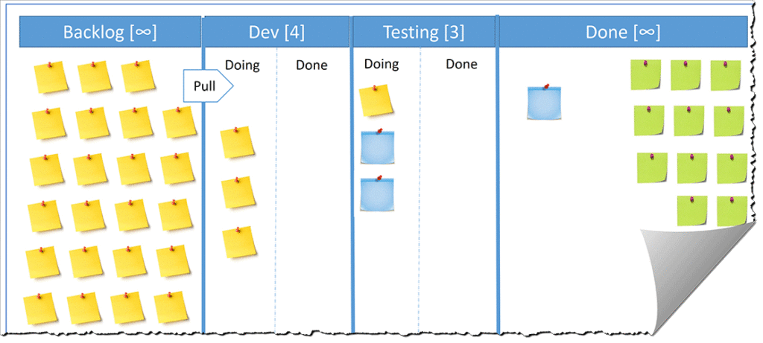
LIFECYCLE MODEL
EXECUTION – PULL WORK
OBJECTIVE
Ensure that work enters execution only when there is capacity and readiness, enabling smooth, efficient, and sustainable flow in a Kanban system.
PARTICIPANTS
Primary Owner: Technical Lead (In Progress) / QA Team (QA) / Business (UAT)
Support: Product Owner / Scrum master
Governance: Portfolio Manager
El primary owner en realidad sería un Tech Lead. El IT program delivery entra a un nivel más macro en la etapa anterior y el governance en esta etapa ya cae a nivel Project manaer .
Pondría el Move-in to progress como etapa final del siguiente etapa
PROCESS
ARTIFACTS
PROCESS: Pull work
Activities
Technical lead checks WIP limits:
The team continuously monitors Work In Progress (WIP) limits in Kanban Board to ensure that ongoing work remains within defined capacity thresholds. This discipline helps prevent overloading the system, reduces context switching, and maintains a stable and predictable delivery flow. It is necessary to have a definition of delivery standards and guidelines before to develop any task.
Technical lead pull highest priority item:
When capacity becomes available, the team pulls the highest priority item from the backlog, ensuring strict adherence to agreed prioritization criteria. This reinforces a pull-based system where work is selected based on business value and readiness, rather than pushed into execution.
Technical lead move to In Progress:
Once the item is selected and validated against readiness criteria, it is moved to “In Progress,” signaling the start of execution. This transition reflects a controlled commitment by the team, ensuring that work only begins when both capacity and clarity are in place. Technical lead needs to ensure the use of coordination mechanisms across teams or domains.
Completion Criteria
Work is pulled, not assigned
1. Kanban Board
  Columns:
  Backlog
  Move-In to Progress
  QA
  UAT
  Done
Best Practices
  Make WIP limits visible
  Use swimlanes for CoS (Class of Service)
Coordination mechanisms across teams or domains
Definition of delivery standards and guidelines
Tools

Slide 80
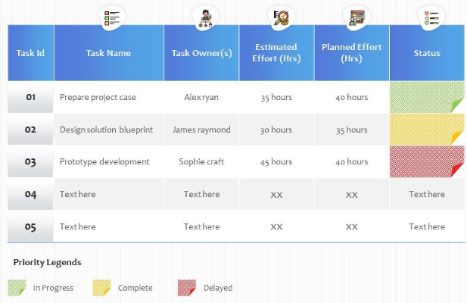
LIFECYCLE MODEL
EXECUTION – ESTIMATION CONFIRMATION
OBJECTIVE
Validate and adjust the expected effort at the start of execution so that delivery remains predictable, aligned, and free of avoidable surprises. The purpose is to ensure team has shared understanding and commitment before starting work.
PARTICIPANTS
Primary Owner: Technical Lead (In Progress) / QA Team (QA) / Business (UAT)
Support: Product Owner / Scrum master
Governance: Portfolio Manager
PROCESS
ARTIFACTS
PROCESS: Estimation Confirmation
Activities
Technical lead review and validate estimation prior to execution:
Before pulling an item into “In Progress,” the development team performs a quick validation of the initial estimation. This includes confirming that the scope remains accurate, no significant unknowns have emerged, and the size of the work is still appropriate for execution within expected timelines. Will be ensured the estimation tracking log is updating the information. The experience in this tasks will be useful to identify patterns.
Technical lead adjust estimation if needed:
If discrepancies or new insights arise, the team updates the estimation accordingly to reflect the current understanding of the work. This helps maintain realistic planning assumptions and supports predictable delivery. This changes have to be based on continuous improvement, not performance evaluation.
Completion Criteria
  Team agrees on effort and scope
  No surprises during execution
Confirm:
  Scope is still valid
  No major unknowns
  Size still reasonable
Adjust estimation if needed
Estimation Tracking Log
Use for continuous improvement, not performance evaluation
Identify patterns (under/over estimation)
Tools

Slide 81
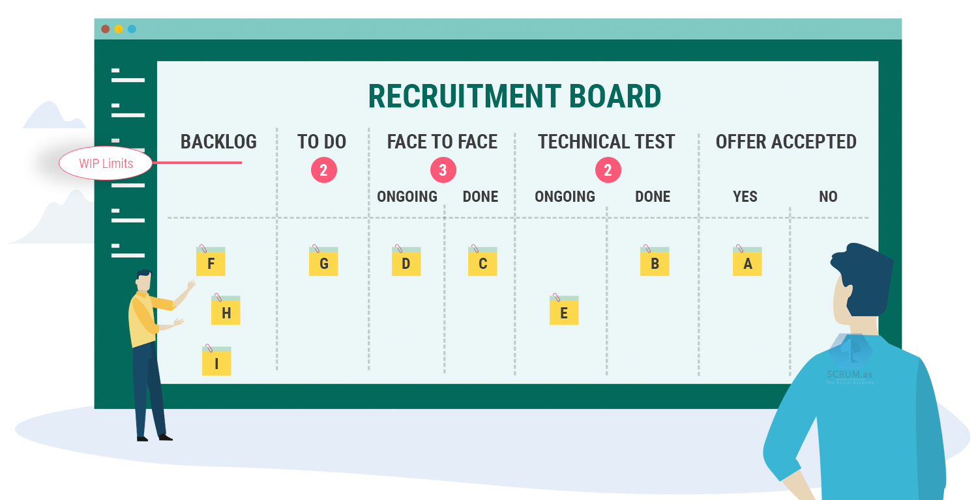
LIFECYCLE MODEL
EXECUTION – MANAGE WIP
OBJECTIVE
Limit active work so the team can focus, maintain flow, expose bottlenecks, and deliver faster with higher quality.
PARTICIPANTS
Primary Owner: Technical Lead (In Progress) / QA Team (QA) / Business (UAT)
Support: Product Owner / Scrum master
Governance: Portfolio Manager
PROCESS
ARTIFACTS
PROCESS: Manage WIP
Activities
Technical lead monitors WIP limits across workflow stages:
The team actively tracks Work In Progress (WIP) limits at each stage of the workflow to ensure ongoing work remains within defined capacity constraints. This visibility helps maintain a balanced flow and quickly highlights emerging bottlenecks. WIP limits are continuously validated using delivery metrics and discussed in delivery review forums (e.g., sprint reviews, demos) to ensure transparency and shared understanding of flow health.
If limit is reached:
Technical lead stops starting new work when WIP limits are reached:
When a WIP limit is exceeded or reached, the team refrains from pulling new items into the workflow. This enforces focus and prevents system overload. Any breaches or risks associated with blocked flow are managed through issue and risk escalation practices, ensuring impediments are surfaced early and addressed promptly. Coordination with other teams or domains is activated when dependencies are involved.
Technical lead swarms to complete work in progress:
The team shifts attention to finishing existing items by collaborating to unblock issues, resolve dependencies, and accelerate completion. During this phase, coordination mechanisms across teams or domains are used to resolve cross-team dependencies, while alignment with business during execution ensures prioritization decisions remain consistent with business objectives and delivery expectations.
Completion Criteria
No WIP limit violations
1. WIP Limits
Delivery review forums (e.g., sprint reviews, demos)
Issue and risk escalation practices
Coordination mechanisms across teams or domains
Alignment with business during execution
Tools

Slide 82

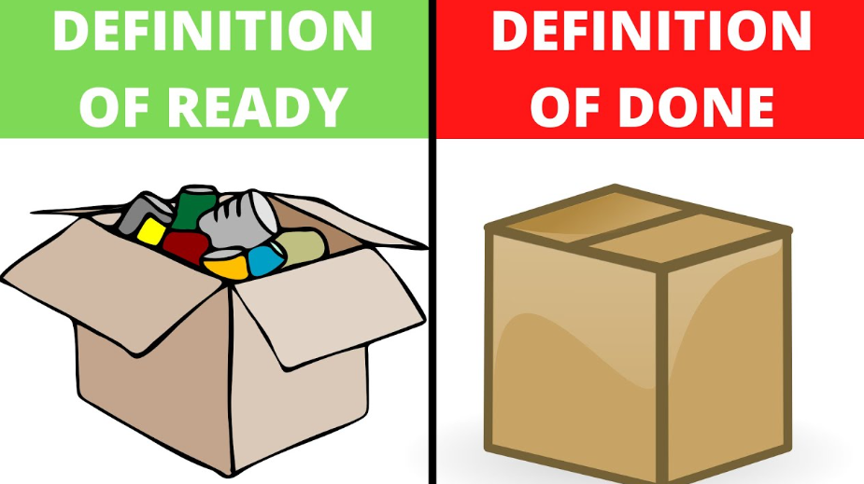
LIFECYCLE MODEL
EXECUTION – CONTINUOUS TESTING QA
DoD
OBJECTIVE
Embed quality into the flow of work by validating continuously, reducing defects, and enabling faster, smoother delivery.
PARTICIPANTS
Primary Owner: Technical Lead (In Progress) / QA Team (QA) / Business (UAT)
Support: Product Owner / Scrum master
Governance: Portfolio Manager
PROCESS
ARTIFACTS
PROCESS: Continuous testing QA
Activities
QA team pulls work from Development:
Quality Assurance uses a pull-based approach, selecting items from Development once they meet the Definition of Done (DoD) and readiness criteria. This aligns testing with actual flow and QA capacity. The process is governed by definition of delivery standards and guidelines, and progress is reviewed in delivery review forums (e.g., sprint reviews, demos) to maintain visibility and alignment.
QA Team executes testing activities:
QA executes functional, integration, regression and other testing to validate acceptance criteria and quality standards. Testing is performed close to development to enable fast feedback. QA also contributes to oversight of delivery progress and performance, and uses coordination mechanisms across teams or domains when dependencies or cross-team work are involved, ensuring alignment with delivery flow and business expectations.
If defect:
QA Team immediate defect feedback loop:
When a defect is found, the item is immediately returned to the previous stage to minimize rework and avoid defect accumulation. Significant issues are managed through issue and risk escalation practices. Where needed, alignment with business during execution ensures prioritization and impact decisions reflect delivery objectives.
Completion Criteria
  All acceptance criteria validated
1. Definition of Done (DoD)
  Delivery review forums (e.g., sprint reviews, demos)
  Issue and risk escalation practices
  Oversight of delivery progress and performance
  Definition of delivery standards and guidelines
  Coordination mechanisms across teams or domains
  Alignment with business during execution
Tools

Slide 83
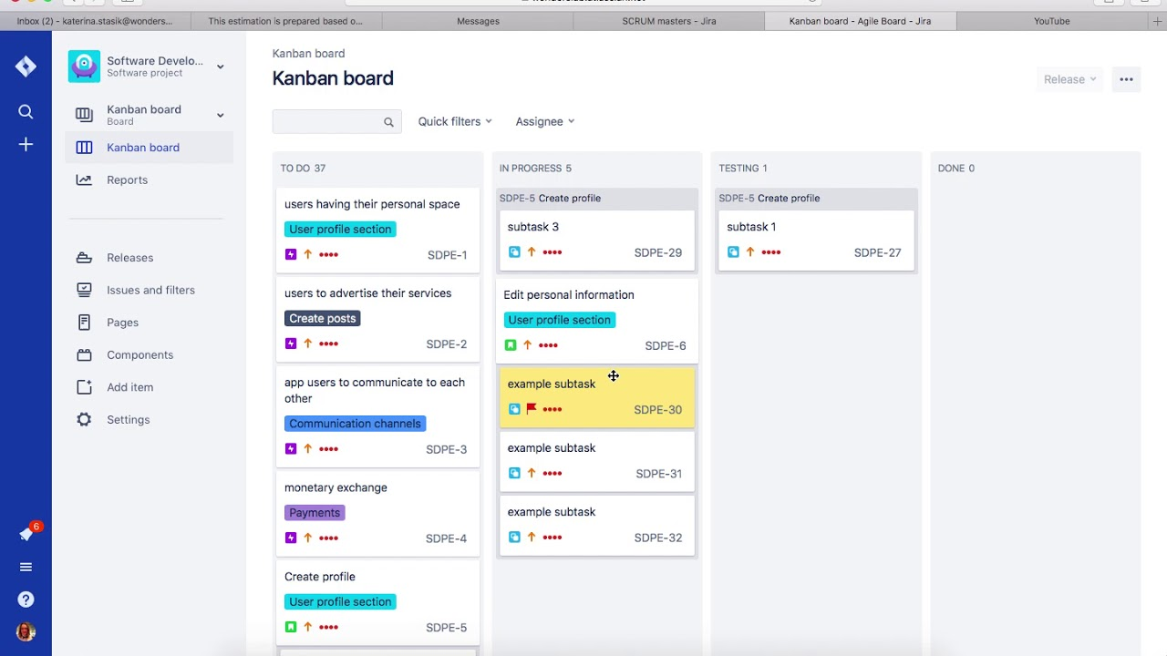
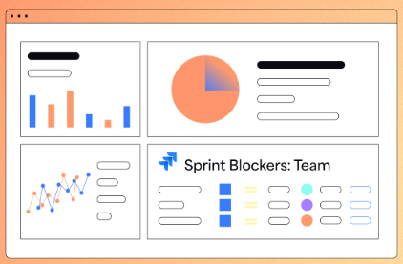
LIFECYCLE MODEL
EXECUTION – BLOCKER MANAGEMENT
OBJECTIVE
Make impediments visible and resolve them quickly, ensuring continuous flow and enabling ongoing process improvement in a Kanban system.
PARTICIPANTS
Primary Owner: Technical Lead (In Progress) / QA Team (QA) / Business (UAT)
Support: Product Owner / Scrum master
Governance: Portfolio Manager
PROCESS
ARTIFACTS
PROCESS: Blocker management
Activities
Technical lead identifies blocked work:
The team proactively detects work items impeded by dependencies, constraints, or unresolved issues. Early identification prevents hidden disruptions to flow and delivery timelines. Blockers are tracked using a Blocker Tracker, ensuring consistent visibility and follow-up.
Technical lead makes blockers visible on the board:
Blocked items are clearly flagged in the workflow (e.g., visual indicators, tags, or dedicated columns), providing transparency to the team and stakeholders. This visibility supports faster response and prioritization of resolution efforts, and is reinforced through issue and risk escalation practices when needed.
Technical lead escalates unresolved impediments:
If a blocker cannot be resolved within the team in a timely manner, it is escalated via appropriate channels (e.g., Technical Lead, Product Owner, or governance forums). This ensures critical issues receive proper attention. Escalation is managed through issue and risk escalation practices, and prioritization decisions remain aligned with delivery objectives via alignment with business during execution.
Completion Criteria
  Blockers resolved quickly
1. Blocker Tracker
  Issue and risk escalation practices
  Alignment with business during execution
Tools

Slide 84
ROLES
FOUR ACCOUNTABILITIES OWN THE DEMAND FLOW END TO END
STAGE 01 · ROLES
Who owns and operates the framework.
Resolves Issues 04 + 07
BUSINESS REQUESTOR
PRODUCT MANAGER [NEW]
ARCHITECT REVIEWER
TRIAGE / DEMAND MGR
Originating business unit
One per Value Stream Team · IT-business bridge
Architecture Council (rotating)
Cross-VS chair
• Submits demand via Jira request type
• Sponsors the request and signs off business value
• Receives status updates through Jira
• Owns backlog priority for the Value Stream
• Owns Pain Score and outcome KPIs
• Bridges IT to business — Process Owners, Demand Manager scope folded in
• Chairs the Portfolio review for the VS
• Provides feasibility view at intake gate (≤2 h)
• Verdict: Feasible · Conditional · Not feasible
• Advisory — does not veto
• Chairs weekly Gate 1 triage (30 min)
• Audits scoring and intake quality
• Escalates cross-VS conflicts to Gate 2
Decides WHAT business outcome is needed
Decides WHEN and IN WHAT ORDER work is done
Decides HOW it should be built
Decides IF the demand is ready to enter the funnel
WHY THE PRODUCT MANAGER ROLE IS NEW
Today Avangrid has Project Managers (PJMs), Sr. Managers and Champions — not Product Managers. The PM role owns outcomes (not just delivery) and is the single accountable name for each Value Stream's portfolio. This role is created from scratch as part of the TOM.

Slide 85
ROLES & RESPONSIBILITIES
NTT DATA
CURRENT PEOPLE AND PROPOSED ROLES
EXISTING LEADERSHIP
Vitor Cruz
Carlos Garbin
Kumar Jaladanki
Heather LaJoie
Travis · PMO Lead
VP IT Business Solutions
Director · IT Business Apps
Director · Customer Services Apps
Director · Product Management
Large Projects PDD
Strategy · sponsor · cross-portfolio sync
IT Apps Portfolio Board owner
CS Apps Portfolio Board owner
Cross-base prioritization layer
Bridge to legacy PDD process
NEW ROLES TO ESTABLISH
Product Manager × 8
Demand Manager
Portfolio Manager
UX Designer
Knowledge Manager
One per Value Stream Team
Cross-team
Cross-portfolio
Cross-team
Cross-team
Outcome owner · scoring · backlog priority
Audits scoring · intake quality · dashboard
VP Dashboard · capacity allocation · monthly sync
Customer journey research · usability testing
Documentation · onboarding · lessons learned
AREA CHAMPIONS — candidates to re-skill into Product Manager roles
Iram Chowdhury — Smart Metering
Andrew McGibbon — G&E
George Porto — GIS
Michael Dubois — Global SAP
Stephanie — SAP / CS
Amit Patel — Corporate
Avangrid · Digital Products · Target Operating Model

Slide 86
CAPABILITIES
14 CAPABILITIES ORGANIZE INTO A FOUR-STAGE DEMAND FUNNEL
STAGE 01 · CAPABILITIES
What the organization must be able to do — end to end.
Resolves Issues 01 + 02 + 06
INTAKE
CLASSIFY
DECIDE
VISUALIZE
• Demand intake channels (Jira request type)
• Standard intake formats (DoR)
• Channel consolidation
• Technical feasibility input
• Demand classification
• Run · Change · Regulatory · Innovation
• Business value definition (Pain Score)
• Acceptance criteria
• Triage & validation (weekly)
• Demand routing & assignment
• Urgent / exception requests (≤20%)
• Demand registration & logging
• Demand visibility & tracking
• Duplicate & overlap identification
▶
▶
▶
ONE FRONT DOOR
DEFINITION OF READY
PAIN SCORE
EXPEDITE CAP
Jira request type replaces Email · Teams · Word · OneNote ad-hoc requests.
Mandatory fields: title · BV · acceptance criteria · CoS · sponsor.
H(x) = (BV·w₁ + UX·w₂) / Effort
Bypass priority capped ≤ 20 % of throughput. No silent overrides.
TAKEAWAY
The 14 capabilities are not a checklist — they are sequenced. Demand only moves stage-to-stage after passing the previous gate, which is what converts inflow into traceable, governed work.
Avangrid · Digital Products · Target Operating Model

Slide 87
FOUR GUIDING PRINCIPLES
EACH PRINCIPLE ANSWERS SPECIFIC STRUCTURAL ISSUES FROM THE AS-IS
01
02
03
04
DEMAND INTAKE & STRUCTURING
VALUE-BASED PRIORITIZATION
PRODUCT PORTFOLIO MGMT & PLANNING
PRODUCT GOVERNANCE & OWNERSHIP
Resolves Issue 01 — No Product Entry Point
Resolves Issues 02 + 06 — No Value-Based Decisioning · No Common Language of Value
Resolves Issue 03 — No End-to-End Product View
Resolves Issues 04 + 05 + 07 — Ownership · Steering · Product Model
• All demand captured through unified intake layer aligned to products / value streams
• Single entry point per product / value stream
• Standard intake criteria and mandatory fields
• Consistent demand categorization (type, size, complexity, value driver)
• Clear ownership for triage and backlog assignment
• Demand evaluated using a standardized framework tied to business outcomes
• Common scoring model: value · urgency · risk · effort
• Transparent prioritization across competing demands
• Product-level backlog ownership
• Trade-offs made at portfolio / product governance level
• End-to-end visibility enables coordinated planning across demand · capacity · delivery
• Integrated portfolio view across all products
• Capacity planning aligned to product priorities
• Roadmaps managed at product level (not project level)
• Continuous tracking of delivery and outcomes
• Clear accountability and governance align decisions to product outcomes
• Defined Squad roles — Product Manager (NEW) · Tech Lead · Business Analyst
• Product-based governance forums with decision rights
• Vendor management aligned to product performance
• KPIs tied to product outcomes and business value

Slide 88
GOVERNANCE
TWO GATES ABSORB THE DEMAND · ONE CADENCE DRIVES THE PORTFOLIO
STAGE 01 · GOVERNANCE
Decisions, forums, and controls that keep the funnel honest.
Resolves Issues 04 + 05
GATE 1 · TRIAGE
GATE 2 · PORTFOLIO
BIG ROOM PLANNING
Weekly · 30 min
Monthly · 90 min
Quarterly · ½ day
Demand Manager (chair) · PMs · Architect
▶
VP · Directors · Product Managers
▶
All VSs + business sponsors + Iberdrola
Accept
Send-back
Reject
Redirect
Prioritize
Defer
Cancel
Re-scope
Confirm WHY
Align HOW
Spot DEPS
Lock OKRs
Filters and routes demand. Verdict logged with reason. SLA: 5 business days.
Trade-offs across Value Streams. Capacity vs CoS commitments. Owns the roadmap.
Cross-portfolio alignment. Surfaces dependencies early and locks quarterly OKRs.
ESCALATION LANE
Cross-VS conflicts → Customer Journey Forum · Cross-portfolio conflicts → VP Portfolio Sync · Every Expedite reviewed at the next Gate 2
TAKEAWAY
Two cadences are sufficient — weekly clears noise, monthly steers value, quarterly aligns the portfolio. Replaces today's mix of ad-hoc forums where 'regulatory always wins' bypassed the queue.

Slide 89
LIFECYCLE END-TO-END PROCESS
April 2026
Digital Products -
Planning & Preparation
IT Business Solutions Delivery

Slide 90
LIFECYCLE END-TO-END PROCESS
May 2026
Digital Products -
Lifecycle Model
03
Definition of the end-to-end product lifecycle, including demand typology, value-based prioritization, governance (RACI), and enabling tools
End-to-End Product Lifecyle
RACI Model & Governance
Tool Ecosystem
IT Business Solutions Delivery

Slide 91
LIFECYCLE END-TO-END PROCESS
May 2026
Digital Products -
Lifecycle Model
03
Definition of the end-to-end product lifecycle, including demand typology, value-based prioritization, governance (RACI), and enabling tools
End-to-End Product Lifecyle
RACI Model & Governance
Tool Ecosystem
IT Business Solutions Delivery

Slide 92
LIFECYCLE END-TO-END PROCESS
May 2026
Digital Products -
Context
01
Overview of the current situation, key challenges, and objectives driving the initiative and design principles for the lifecycle process
Methodology
02
Structured approach outlining phases, activities, and inputs used to assess the current state and define the target model
Lifecycle Model
03
Definition of the end-to-end product lifecycle, including demand typology, value-based prioritization, governance (RACI), and enabling tools
Portfolio Concept Blueprint
04
Target portfolio structure and tool ecosystem, including key gaps and conceptual design for integrated portfolio management
Pilot Readiness & Next Steps
05
Key actions to enable implementation, including pilot definition, readiness considerations, and roadmap for rollout
IT Business Solutions Delivery

Slide 93
LIFECYCLE END-TO-END PROCESS
May 2026
Digital Products -
Context
01
Overview of the current situation, key challenges, and objectives driving the initiative and design principles for the lifecycle process
Methodology
02
Structured approach outlining phases, activities, and inputs used to assess the current state and define the target model
Lifecycle Model
03
Definition of the end-to-end product lifecycle, including demand typology, value-based prioritization, governance (RACI), and enabling tools
Portfolio Concept Blueprint
04
Target portfolio structure and tool ecosystem, including key gaps and conceptual design for integrated portfolio management
Pilot Readiness & Next Steps
05
Key actions to enable implementation, including pilot definition, readiness considerations, and roadmap for rollout
IT Business Solutions Delivery

Slide 94
FIELD PROGRESSION
FIELD PROGRESSION
WHO FILLS WHAT · WHEN · the card grows as it advances through the funnel
WHO FILLS WHAT · WHEN · the card grows as it advances through the funnel
FUNNEL · SUBMIT
REVIEWING
ANALYZING
GATE 2 · PORTFOLIO
OWNER
OWNER
OWNER
OWNER
Requester
Product Manager (per VS)
PM (per VS) + Architect
Director (Carlos · Kumar · Heather · IT Program Delivery Manager)
at intake · Jira form
SLA: 2 weeks · post-Gate 1
Pain Score auto-fires (A4)
Monthly · 90 min
FIELDS ADDED HERE
FIELDS ADDED HERE
FIELDS ADDED HERE
FIELDS ADDED HERE
BUSINESS CONTEXT
CLASSIFICATION
SCORES (1–5)
CAPACITY
Title · Description · Business Value (narrative) · Acceptance Criteria
Type (Production Support - Regulatory - Non - Regulatory)
ITBA: BV · UX · Safety · Effort
CS: BV · UX · Effort
Slot to Value Stream · quarter assignment
ROUTING
SIZE · INITIAL
PAIN SCORE · AUTO
INPUTS REVIEWED
Value Stream · OPCO · Sponsor
T-shirt: S · M · L — best-guess (XL → PPM Now)
ITBA: (BV·OPCO mult·w₁ + UX·w₂ + Safety·w₃) / Effort
CS: (BV·OPCOmult· w₁ + UX· w₂ ) / Effort
Pain Score · Discovery Report · Feasibility · capacity
FLAGS
CoS · INITIAL
FINAL SIZE / CoS
OUTPUTS
Customer Impact Tier (P1–P4 if known)
Standard / Fixed-Date / Expedite / Intangible — best-guess
Locked after Architect review
Backlog rank · status = Ready For Execution
DECISION
Preparation & Planning
Si es Go, puede irse a un nuevo proyecto o hcerse un nuevo proyecto
Resolver esta indefinición
Como se hace el capacity planning
Qúe pasa si es go/no-go, resolver roadmapping, licencias y ejecución de los prouectos. Qué tiene que pasar. Poner my claor y muy básico. Más desde visión de producto
Classification y Triage
Go / No-Go / Defer · judgment on the assembled card
Single funnel ends siloed intake → one source of truth for OVS-level KPIs (NPS · CSAT · Reliability · cycle time) · Architect adds feasibility at Analyzing · Director judges the assembled card at Gate 2.
ARTIFACTS
Discovery Report · Concept Prototype · Feasibility check

Slide 95
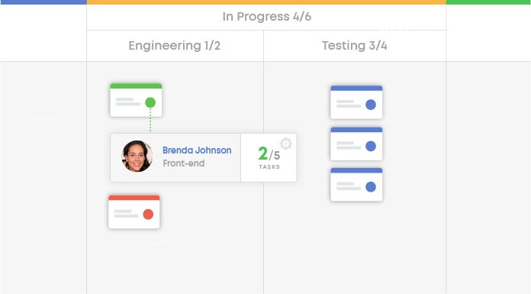
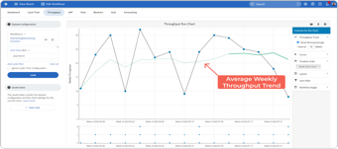
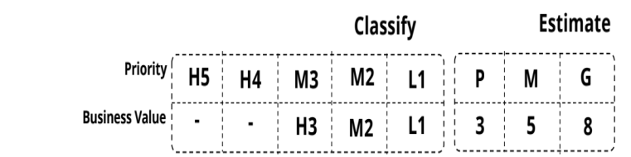
EXECUTION
Intake of work from prioritized backlog
Intake of work from prioritized backlog
Work breakdown (epics, stories, tasks) Sprint / iteration management & Work prioritization at team level
Development and build practices & Testing practices
Governance & Tactical Meetings
Final Stakeholder Demo
Sign Off
Release
Backlog Management
(Roadmap + Jira + PBB))
“Bite size” Stories
Backlog Refinement
Daily Meeting
Reviews
PM / Signs Off
Story
Epic
Epic
Epic
Epic
Backlog
Done
Request by business value
Epic
Epic
Epic
Epic
Metrics & Project Results Dashboards / Artifact (Pulse + FlowMetrics)
Project Estimation
(Coorg + T-shirt S.E)
Workflow Management
(Lightweight Method)
Activitie 1: Intake of work from prioritized backlog
Activitie2: Work breakdown (epics, stories, tasks)Sprint / iteration management
Activitie 2: Work prioritization at team level
Artifact: Definition of Ready (or equivalent readiness practices)
Artifact: Definition of Done (or completion criteria)
Activitie 3: Development and build practices
Activitie 3: Testing practices (unit, integration, functional, UAT)
Sub Activitie Defect management
Sub Activitie Dependency management (intra- and inter-team)
Sub Activitie Cross-team coordination
Activitie 4: Work progress tracking and visibility
Artifact: Documentation of functional and technical aspects
Request by business value
1BP = 8 EPICS = 100 PBIs = 100%
EPIC 3 = 15 PBIs = 15%
6 PBIs IN PROGRESS = 6%
6 PBIs FINISHED = 6%
Organize the Project in WBS to Provide Estimates
Organize Projects in Backlogs allows for Planning, Prioritization and Work Distribution
Manage Projects in Visual Boards allows for Instant Progress Reports, Issues mitigation and Risk management, as well as efficiency metrics
Metrics for Project Completion will be automatic, reducing repetitive work from PMs.

Slide 96









BIG ROOM PLANNING CYCLE
Governance Model
In the iterative cycles pattern, we can create the specific process governance to secure operational excellence and value focus throughput every productive quarter cycle.
Standard Work Flow
New Demand Flow
Change Flow
QUARTER
Month 1
Month 2
Month 3
Portfolio
Portfolio Discovery Funnel
Portfolio Discovery Funnel
Portfolio Discovery Funnel
P&S Portfolio
Review (QBR ^{/1)}
Program
BRP
Event ^{/3}
Portfolio
SynC ^{/2}
Shark Tank
Portfolio
SynC ^{/2}
Portfolio
SynC ^{/2}
Portfolio Committee
Portfolio
SynC ^{/2}
Portfolio
SynC ^{/2}
Portfolio
SynC ^{/2}
Program Checkpoint
Program Chapter
Portfolio Chapter
Go-No Go Meeting
Program Review
Program Checkpoint
Program Chapter
Portfolio Chapter
Go-No Go Meeting
Program Review
Program Checkpoint
Program Chapter
Portfolio Chapter
Go-No Go Meeting
Program Review
Full E2E Task Management Ecosystem for Portfolio with Jira
Product Management
Iteration 1.1
Iteration 1.2
Iteration 1.3
Research Interviews Sessions
Design Thinking Workshop (LI)
Research Interviews Sessions
Design Thinking Workshop (LI)
Research Interviews Sessions
Design Thinking Workshop (LI)
Discovery Workshops
Design Thinking Workshop (DS)
Discovery Workshops
Design Thinking Workshop (DS)
Discovery Workshops
Design Thinking Workshop (DS)
Project Weekly / Daily Checkpoint
Project Weekly / Daily Checkpoint
Project Weekly / Daily Checkpoint
Project Delivery
Project Kickoff
Replenishment
Change
Review
Project Kickoff
Replenishment
Change
Review
Project Kickoff
Replenishment
Change
Review
Project Planning
Daily Checkpoint
Adapt
Iteration Release
Project Planning
Daily Checkpoint
Adapt
Iteration Release
Project Planning
Daily Checkpoint
Adapt
Iteration Release
Product Chapter
Project
Chapter
Chapter
Chapter
Product Chapter
Project
Chapter
Chapter
Chapter
Product Chapter
Project
Chapter
Chapter
Chapter
1/ It's the Strategic P&S Portfolio Review to occure monthly
2/ Experiment a Bi-weekly Portfolio Sync
3/ Big Room Planning Event to produce 90days plan;
Strategic Artifacts & Deliverables
Portfolio Specific Governance Meetings
Tactical Governance Meetings
Product and Project Meetings
PROGRAM MANAGER
TECHNICAL LEADER
PROJECT MANAGER
CHANGE MANAGER
PORTFOLIO MANAGER
MANAGEMENT
PRODUCT MANAGER
KAIZEN EXPERT

Slide 97
LIFECYCLE MODEL
PREPARATION & PLANNING – CAPACITY ALLOCATION
OBJECTIVE
Review Epic, user stories and task to have a project plan that will be split between sprints. It will allow to align the stakeholders and future developments.
PARTICIPANTS
Portfolio manager
Product Manager
IT program delivery
Architect reviewer
PROCESS
ARTIFACTS
PROCESS: Backlog review
Activities
Internal business review meeting (per team):
The Product Manager reviews and updates epics, user stories, and tasks to ensure alignment with development planning. During this session, epics are broken down into smaller, actionable items that can be clearly understood by all involved teams (business, IT, etc.). Definition of Ready (DoR) and Definition of Done (DoD) criteria must be included for each user story.
Weekly business and IT alignment meeting:
The Product Manager presents business needs to the IT Program delivery to assess technical feasibility and identify any constraints or dependencies.
Bi-weekly global alignment meeting:
The Portfolio Manager coordinates with all stakeholders to prepare upcoming sprints. This includes prioritizing work items and ensuring that IT teams have sufficient information to proceed with solution design and provide development timelines.
Weekly technical prioritization meeting:
The IT program delivery reviews and prioritizes technical tasks evaluating them to define timelines for inclusion in the project plan. This information is then shared in the subsequent bi-weekly global alignment meeting. Tasks have to be approved by Architect reviewer.
Completion Criteria
  Every user story must contain DoR and DoD before to be included in the backlog
  Business and IT approvals
Capabilities included in this steps:
Work breakdown (epics, stories, tasks)Sprint / iteration management
Definition of Ready (or equivalent readiness practices)
Definition of Done (or completion criteria)
Dependency management (intra- and inter-team)
2. Artifacts
Product Backlog
Project Backlog and Project plan
Sprints
Definition of delivery standards and guidelines
Coordination mechanisms across teams or domains
Alignment with business during execution
Tools

Slide 98

PREPARATION PLANNING
PROCESSES AND ARTIFACTS – Continuous Backlog Prioritization
INTAKE (Idea)
→
DTO Project Committee
READY FOR EXECUTION
→
EXECUTION
→
DONE
Objective
Keep the work queue aligned with current business priorities so teams can pull the right work at the right time and maintain efficient, value-driven flow.
Demand Management
BACKLOG
Jira Intake
Classify Work
Triage DoR
Primary Owner: Product Owner / Tech Lead
Support: Business Stakeholders
Governance: Project Manager
Demand Backlog
Preparation & Planning
Priority Backlog
Story
Priority Framework
PROCESS: Continuous Backlog Prioritization
How to Execute
Review backlog daily/weekly
Reorder based on:
  Value
  Urgency
  Risk
Ensure top items are ready to pull
Completion Criteria
Top 5–10 items always ready
Backlog is continuously ordered
Story
Capacity Allocation
Flow Metrics
Story
Pre-Estimation
Story
Execution & Delivery
Sort by business value
Initiative 1
Pull Work
Story
Estimation
Story
WIP
DoD
Blocker Tracker
Deployment
ARTIFACT: Prioritized Backlog
How to Maintain
Single queue in Jira
Sorted top → bottom by priority
Best Practices
  Avoid multiple backlogs
  Keep it short and actionable
Flow Metrics
Cadences
Cont. Improvement
Blocker Tracker
6

Slide 99
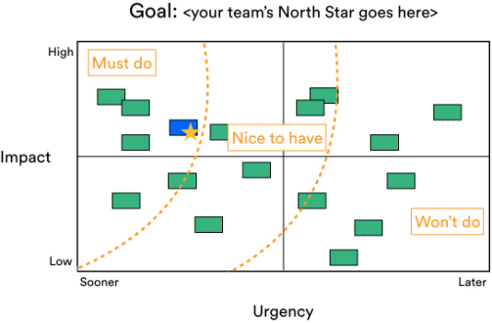
PREPARATION PLANNING
PROCESSES AND ARTIFACTS – Apply Prioritization Criteria
INTAKE (Idea)
→
DTO Project Committee
READY FOR EXECUTION
→
EXECUTION
→
DONE
Objective
Ensure that backlog decisions are consistent, transparent, and focused on delivering the highest value work in the most effective order.
Demand Management
BACKLOG
Jira Intake
Classify Work
Triage DoR
Primary Owner: Product Owner / Tech Lead
Support: Business Stakeholders
Governance: Project Manager
Preparation & Planning
Priority Backlog
Priority Framework
PROCESS: Apply Prioritization Criteria
How to Execute
Use a simple scoring model:
Completion Criteria
  Priorities are objective, not opinion-based
Capacity Allocation
S
M
B
Flow Metrics
Pre-Estimation
Criteria | Example
Business Value | Revenue, risk reduction
Urgency | Deadline, production issue
Effort | Small vs large
Risk | Dependencies
Execution & Delivery
Pull Work
Estimation
WIP
DoD
Blocker Tracker
ARTIFACT: Prioritization Framework
How to Create
Use simple scoring:
  High / Medium / Low OR
  Weighted score
Best Practices
  Keep it lightweight
  Avoid over-engineering
Deployment
Flow Metrics
Cadences
Cont. Improvement
Blocker Tracker
6

Slide 100
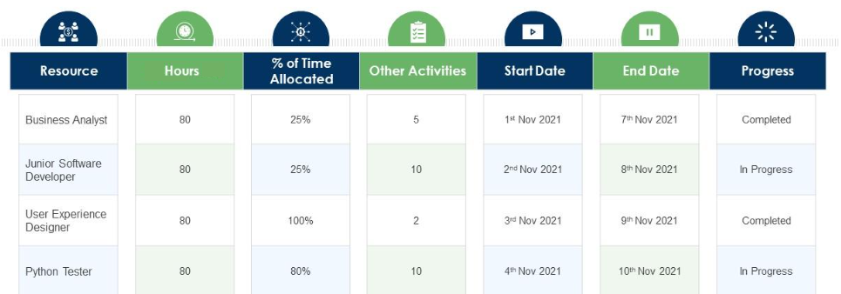
PREPARATION PLANNING
PROCESSES AND ARTIFACTS – Capacity Allocation
INTAKE (Idea)
→
DTO Project Committee
READY FOR EXECUTION
→
EXECUTION
→
DONE
Objective
Intentionally control how team effort is distributed so that all critical types of work are delivered without overloading the system or compromising flow.
Demand Management
BACKLOG
Jira Intake
Classify Work
Triage DoR
Primary Owner: Product Owner / Tech Lead
Support: Business Stakeholders
Governance: Project Manager
Preparation & Planning
Priority Backlog
Priority Framework
PROCESS: Capacity Allocation
How to Execute
Define % allocation:
  Build: 60%
  BAU: 25%
  Upgrades: 15%
Monitor actual vs planned
Adjust if imbalance occurs
Completion Criteria
  Work types are balanced
  No overload of BAU
Capacity Allocation
Flow Metrics
Pre-Estimation
Execution & Delivery
Pull Work
Estimation
WIP
DoD
Blocker Tracker
Deployment
Flow Metrics
Cadences
ARTIFACT: Capacity Allocation Model
How to Use
Document % split
Use it to guide prioritization
Cont. Improvement
Blocker Tracker
6

Slide 101
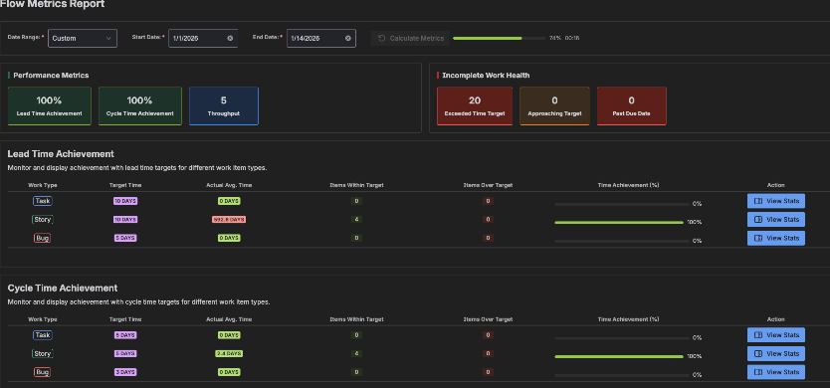
PREPARATION PLANNING
PROCESSES AND ARTIFACTS – Backlog Review Cadence
INTAKE (Idea)
→
DTO Project Committee
READY FOR EXECUTION
→
EXECUTION
→
DONE
Objective
Continuously refine and prioritize the backlog so that high-quality, ready work is always available to sustain efficient Kanban flow.
Demand Management
BACKLOG
Jira Intake
Classify Work
Triage DoR
Primary Owner: Product Owner / Tech Lead
Support: Business Stakeholders
Governance: Project Manager
Preparation & Planning
Priority Backlog
Priority Framework
PROCESS: Backlog Review Cadence
Purpose
Ensure backlog remains aligned, prioritized, and data-driven
How to Execute
Schedule weekly backlog review session
Participants:
  Product Owner
  Key stakeholders
  Project Manager (facilitator)
Review:
  Top backlog items
  New incoming demand
  Aging items
Use metrics to adjust priorities:
  Items waiting too long
  Cycle time trends
  Throughput capacity
Reorder backlog accordingly
Completion Criteria
  Backlog is updated and aligned with stakeholders
  Top items are ready + prioritized
ARTIFACT: Flow Metrics Dashboard (Used for Prioritization)
How to Use
Track:
  Lead Time (idea → done)
  Cycle Time (in progress → done)
  Throughput (items/week)
  Aging work items
Best Practices
  Use trends, not single data points
  Highlight bottlenecks influencing prioritization
Capacity Allocation
Flow Metrics
Pre-Estimation
Execution & Delivery
Pull Work
Estimation
WIP
DoD
Blocker Tracker
Deployment
Flow Metrics
Cadences
Cont. Improvement
Blocker Tracker
6

Slide 102
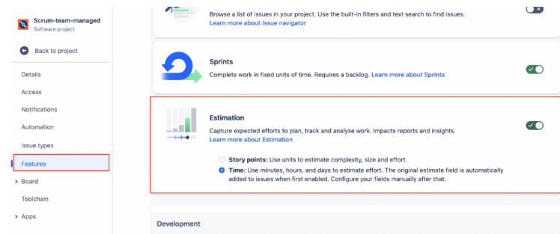
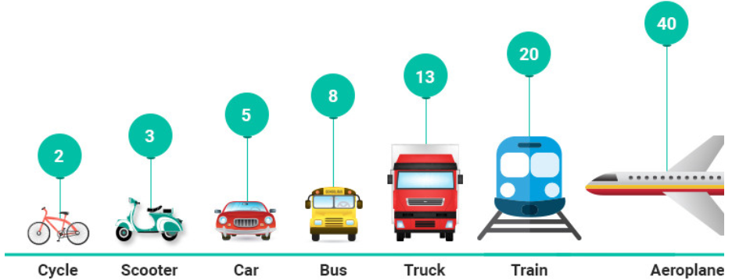
PREPARATION PLANNING
PROCESSES AND ARTIFACTS – Pre-Estimation of Stories
INTAKE (Idea)
→
DTO Project Committee
READY FOR EXECUTION
→
EXECUTION
→
DONE
Objective
Ensure work is well-understood, appropriately sized, and predictable before it enters execution—enabling smoother flow and better decision-making.
Demand Management
BACKLOG
Jira Intake
Classify Work
Triage DoR
Primary Owner: Product Owner / Tech Lead
Support: Business Stakeholders
Governance: Project Manager
Preparation & Planning
Priority Backlog
Priority Framework
PROCESS: Pre-Estimation of Stories
Purpose
Provide lightweight effort sizing to support prioritization decisions
How to Execute
During backlog refinement:
  Dev team reviews upcoming items
Assign relative size:
  Hours - Time
Focus on:
  Complexity
  Effort
  Unknowns
Do NOT over-analyze → keep it fast
Completion Criteria
  Top backlog items have estimated size
  Enough confidence for prioritization decisions
Capacity Allocation
Flow Metrics
Pre-Estimation
Execution & Delivery
Pull Work
Estimation
WIP
ARTIFACT: Estimation Board / Tracker
How to Create
Options:
Jira field (Story Points / Size / hours)
Simple board view showing:
  Item
  Size
  Owner
  Confidence level
Best Practices
  Use relative estimation
  Track estimation vs actual trends (for learning, not control)
DoD
Blocker Tracker
Deployment
Flow Metrics
Cadences
Cont. Improvement
Blocker Tracker
6

Slide 103
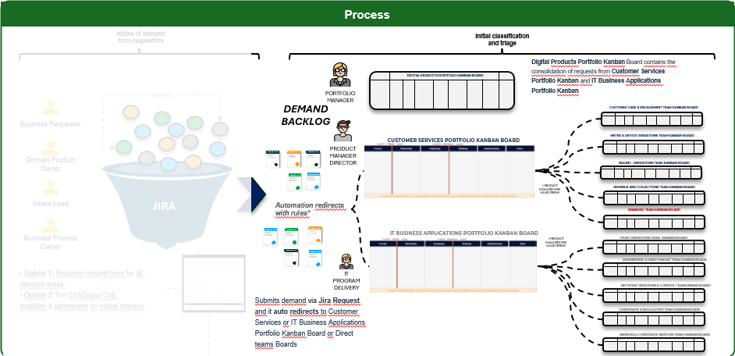
LIFECYCLE MODEL – DEMAND MANAGEMENT
INITIAL CLASSIFICATION AND TRIAGE: Demand type and Size
Javi
TYPE · Type: Production Support · Regulatory · Non-Regulatory · Size: S · M · L · XL
Demand Size
● REVIEWING · PM
SIZE · drives auto-conversion to Story / Epic / Initiative
S
Small · < 5 days · < $10k · 1 squad
• Direct to Squad's Team Kanban
• Skips Portfolio Gate
• Lightweight DoR — title · BV · acceptance criteria
• Triage SLA: 2 business days
• Sponsor: sub-team lead
M
Medium · 5–20 days · < $500k · 1 squad
• Direct to Squad — flagged for awareness at Portfolio
• Lightweight Discovery (1–2 weeks)
• Standard DoR — adds CoS · OPCO · Pain Score
• Triage SLA: 5 business days
• Sponsor: business unit lead
L
Large · 20–60 days · 1–2 squads
• Full Discovery — outcome · users · solution shape
• Full DoR — adds budget · vendor model · architecture review
• Triage SLA: 5 business days · Gate decision next monthly
• Sponsor: Director (Carlos / Kumar / Heather)
XL
Extra-Large · > 90 days · cross-area
• MANAGED IN PPM Now
⚠ IT Now is reserved for incidents only — not for new demand

Slide 104
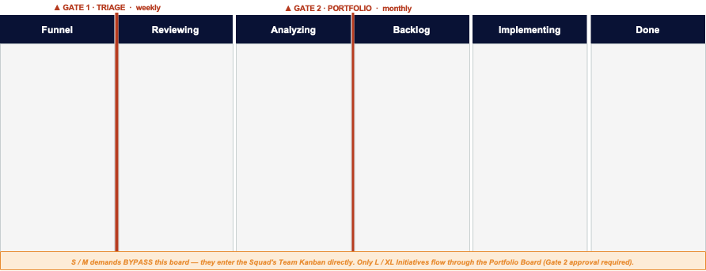




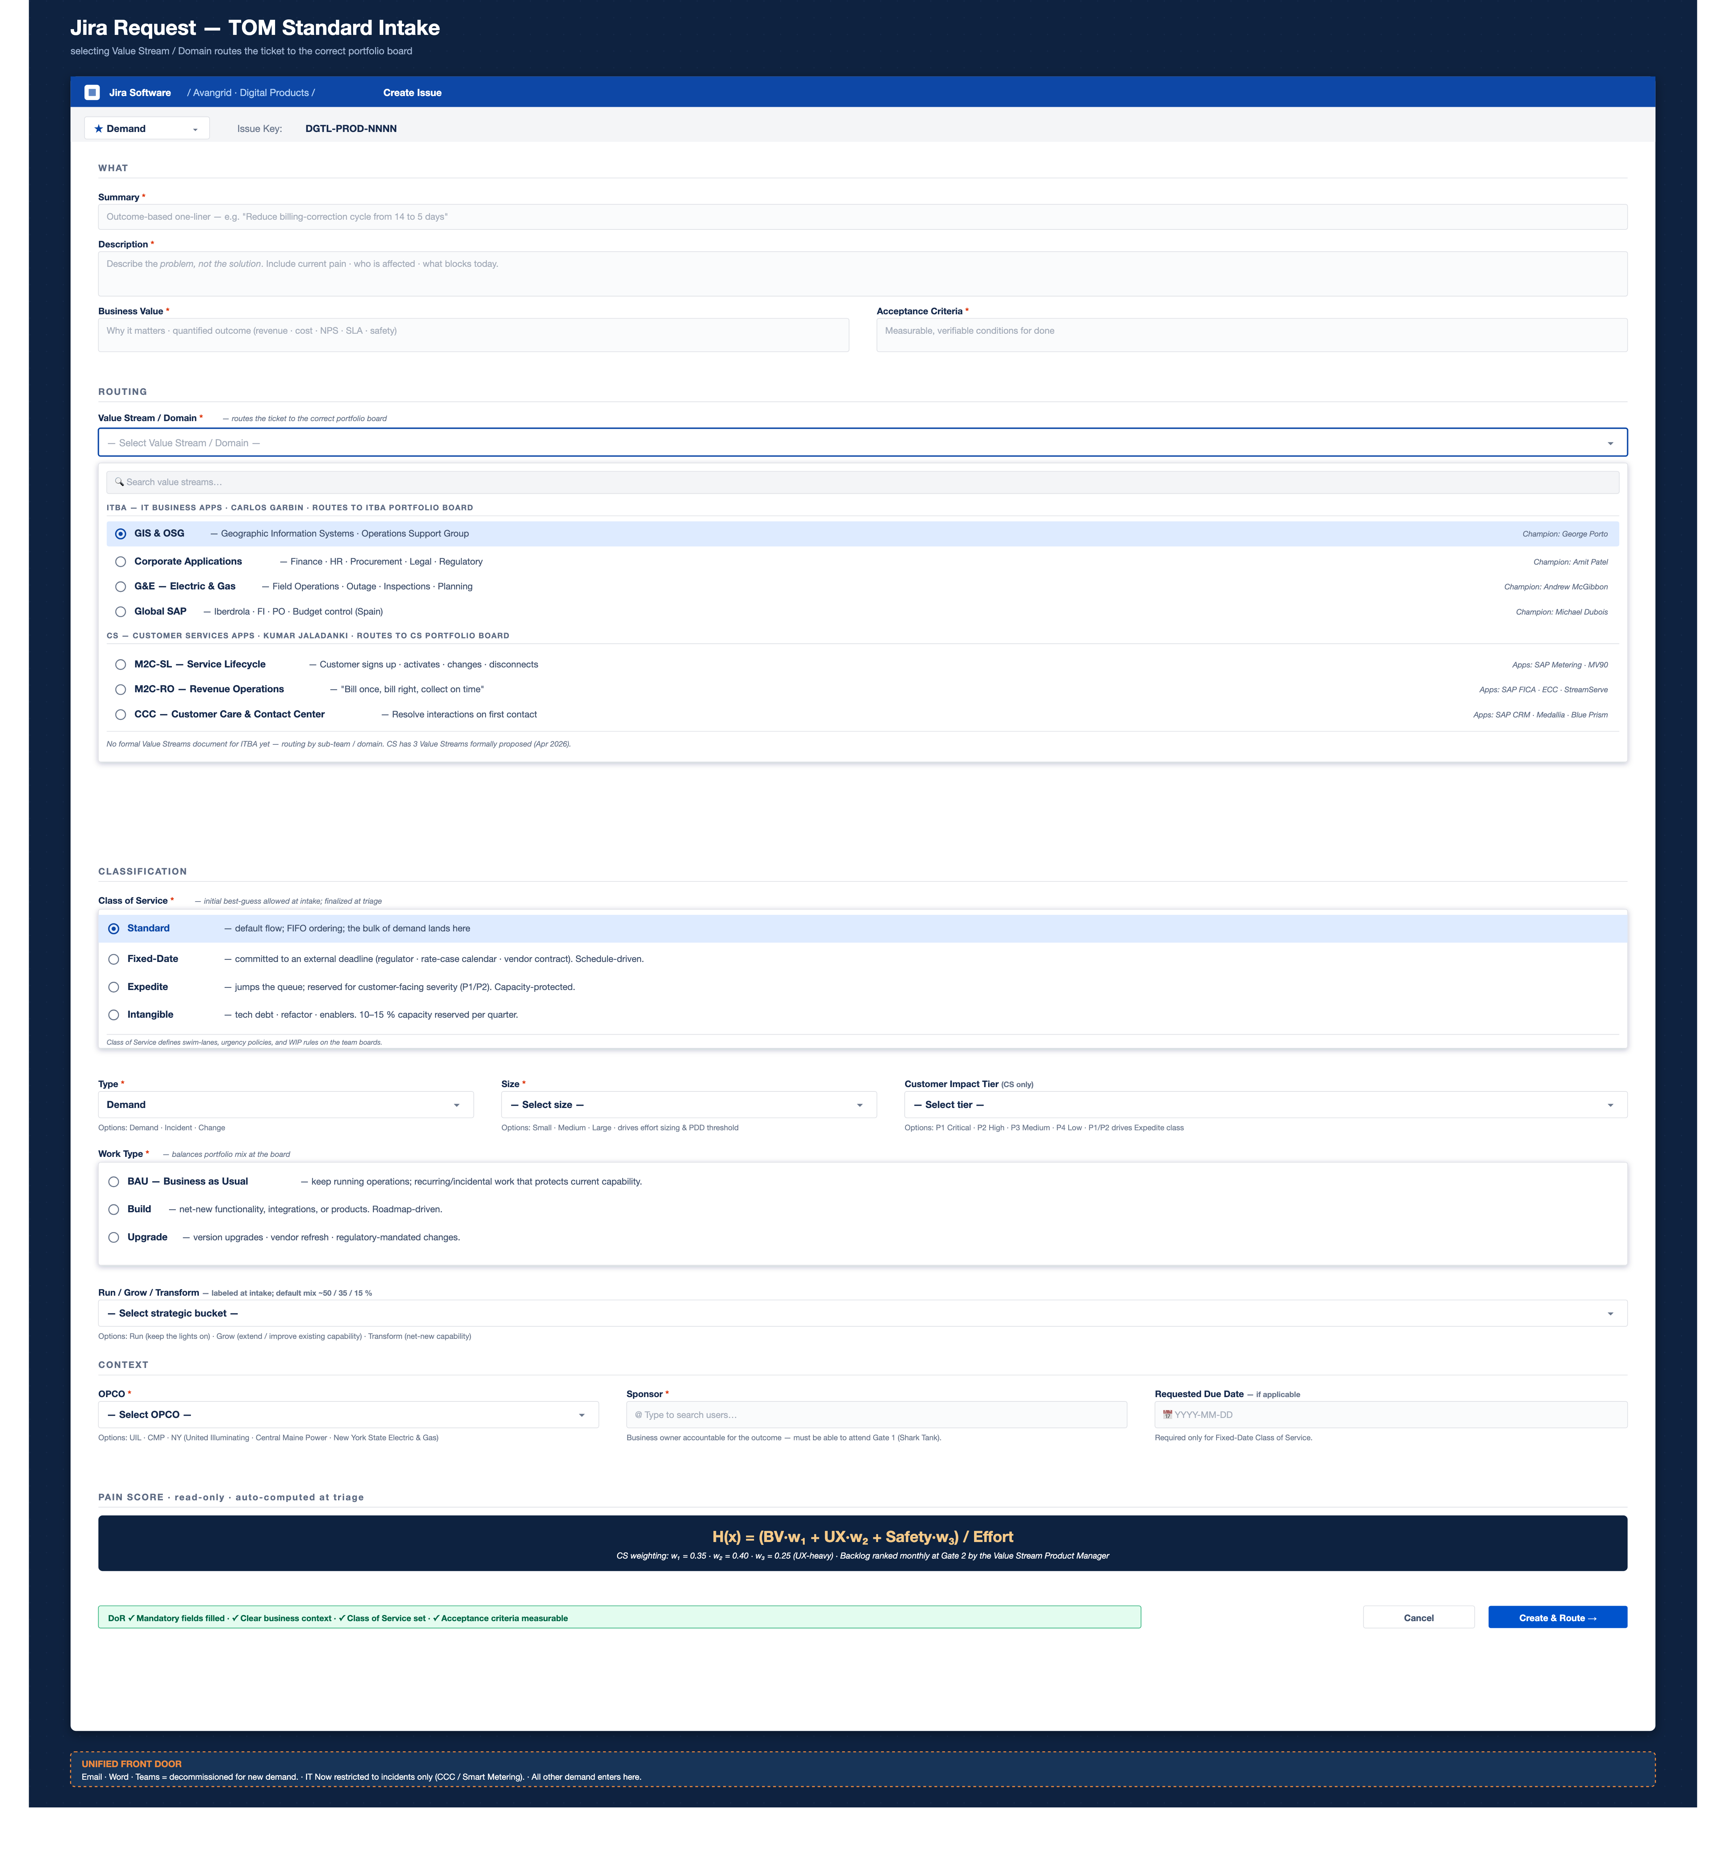
LIFECYCLE MODEL – DEMAND MANAGEMENT
PROCESS OVERVIEW
We defined a process structured across two key stages—intake and triage—to ensure consistent capture, classification, and routing of requests. It engages key roles across business, product, and technology to enable early validation, prioritization, and alignment with business needs.
Roles
Process
Intake of demand from requestors
Initial classification and triage
Business requester / intake lead / business process owner
Digital Products Portfolio Kanban Board contains the consolidation of requests from Customer Services Portfolio Kanban and IT Business Applications Portfolio Kanban
DIGITAL PRODUCTS PORTFOLIO KANBAN BOARD
REQUESTS
PORTFOLIO MANAGER
DEMAND BACKLOG
CUSTOMER CARE & ENGAGEMENT TEAM KANBAN BOARD
Business Requester
CUSTOMER SERVICES PORTFOLIO KANBAN BOARD
METER & DEVICE OPERATIONS TEAM KANBAN BOARD
Portfolio manager
PRODUCT MANAGER DIRECTOR
Domain Product Owner
BILLING OPERATIONS TEAM KANBAN BOARD
Product manager director
1 PRODUCT MANAGER PER VALUE STREAM
REVENUE AND COLLECTIONS TEAM KANBAN BOARD
Intake Lead
JIRA
Automation redirects
with rules*
ENABLING TEAM KANBAN BOARD
Business Process Owner
IT BUSINESS APPLICATIONS PORTFOLIO KANBAN BOARD
1 PRODUCT MANAGER PER VALUE STREAM
FILED OPERATIONS TEAM KANBAN BOARD
IT program delivery
• Option 1: Required request form for all demand areas.
• Option 2: For CX&Digital CoE establish a partnership an intake process
ENGINEERING & ASSET MNGMT TEAM KANBAN BOARD
IT PROGRAM DELIVERY
NETWORK OPEATIONS & CONTROL TEAMKANBAN BOARD
Submits demand via Jira Request and it auto redirects to Customer Services or IT Business Applications Portfolio Kanban Board or Direct teams Boards
CORPORATE & REGULATORY TEAM KANBAN BOARD
Architect reviewer
IBERFROLA CORPORATE SERVICES TEAM KANBAN BOARD
Tools
Governance
GATE 1 · TRIAGE
GATE 2 · PORTFOLIO
Performance
Demand volume
DoR Pass Rate
Triage lead time
Channel adoption

Slide 105
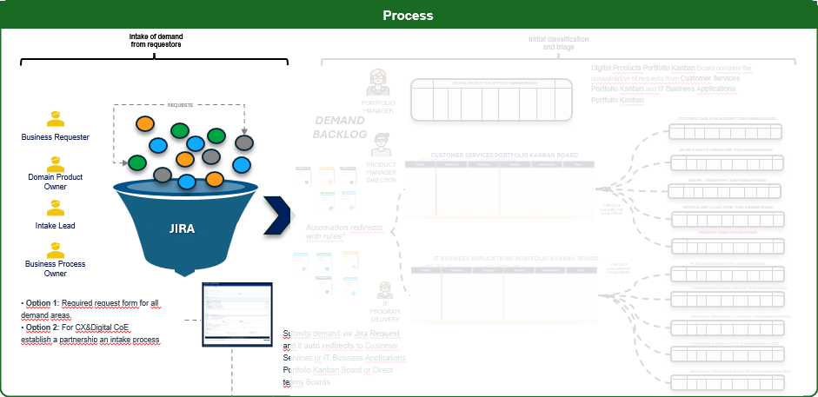
LIFECYCLE MODEL – DEMAND MANAGEMENT
INTAKE OF DEMAND FROM REQUESTORS: Field guide – customer impact
TYPE · Single-select · 4 options · CS only · optional at submit
● REQUESTER (if known) / PM at Reviewing
Customer Impact Tier
P1
P2
P3
P4
CRITICAL
HIGH
MEDIUM
LOW
> 100k customers OR full OPCO outage
> 10k customers · degraded service
single-OPCO non-critical issue
internal-only · no customer impact
WHEN TO USE
WHEN TO USE
WHEN TO USE
WHEN TO USE
Production outage affecting full customer base of an OPCO · service unavailable · revenue impact > $100k/day
Significant degradation but service continues · workarounds available · regulatory deadline imminent
One OPCO affected · workarounds in place · low complaint volume · not customer-facing severity
Internal users only · agent-side or back-office tooling · no customer-facing implications
AUTO-TRIGGER
AUTO-TRIGGER
AUTO-TRIGGER
AUTO-TRIGGER
A2 Auto-Expedite · CoS=Expedite · WIP-1 · 4-hour SLA
A2 Auto-Expedite · CoS=Expedite · WIP-1 · 8-hour SLA
No automation · Standard CoS · 24-hour SLA · normal triage flow
No automation · Standard or Intangible CoS · 72-hour SLA
EXAMPLES
EXAMPLES
EXAMPLES
EXAMPLES
Billing engine down · IVR fully offline · Iberdrola month-close blocker
CRM partial outage · Genesys queue routing failure · payment gateway slow
Localized billing display issue · UI glitch on a single OPCO · dashboard slow
Internal report formatting · agent dashboard tweak · documentation update
HOW IT AFFECTS THE CALCULATION
▸ CIT does NOT enter the Pain Score formula — it is a CATEGORICAL FLAG, not a numeric weight
▸ P1 / P2 → triggers A2 Auto-Expedite → forces CoS = Expedite + WIP-1 → jumps the queue regardless of Pain Score
▸ P3 / P4 → no automation → follows Pain Score ranking + CoS lane normally
MANDATORY? · Optional at submit (Requester fills if known) · Reviewing PM may add later · empty = Standard CoS default

Slide 106
LIFECYCLE MODEL – DEMAND MANAGEMENT
INITIAL CLASSIFICATION AND TRIAGE: Business Value
TYPE · Rich text + numeric BV component (1–5 score)
Business Value
● NARRATIVE: FUNNEL · REQUESTER / SCORE: ANALYZING · PM
BV COMPONENT — 5-point scoring guide
TEXT NARRATIVE — quantify the outcome
ONE of 4 inputs into Pain Score · scored at Analyzing by PM
✓ INCLUDE NUMBERS
5
TRANSFORMATIONAL
▸ $ impact
$2M/yr cost avoidance · $500k revenue uplift
Multi-million impact · safety · existential business risk
▸ % delta
NPS +5 points · CSAT 78% → 88%
▸ Time saved
240 hrs/cycle · 5 days off cycle time
4
VERY HIGH
▸ Volume
1,200 errors/cycle · 8% of inbound calls
Major contribution to OPCO results · customer NPS shift · year-end target
▸ Compliance
PUC mandate · SOX gap · OSHA finding
▸ Safety (ITBA) / Customer Reliability (CS)
ITBA · field crew · public hazard · near-miss CS · uptime · NPS hits · service availability (ITBA only · CS uses Customer Reliability instead)
3
HIGH
✗ AVOID
Moderate gain · cost / time / quality measurable improvement
✗ Strategic alignment · Industry best practice
✗ Customer satisfaction (without number)
2
✗ It would be nice to have · Future-proofing
LOW
✗ Better experience (without metric)
Limited gain · convenience · efficiency · single team
EXAMPLE — high BV statement
1
"Reducing billing-correction cycle from 14 to 5 days saves 240 hrs/cycle (~$285k/yr labor) and reduces inbound complaints by ~8% (480 calls/cycle). Aligns with 2026 NPS target +5. BV = 4 (VERY HIGH).
MINIMAL
Cosmetic · nice-to-have · no measurable business impact
WHY IT MATTERS
TRIGGERS / DRIVES
Reviewers can't game ranking
▸ Pain Score · BV component · ITBA: w₁=0.45 · CS: w₁=0.40 · Gate 2 review · Portfolio Committee defense
Notes:
TRANSFORMATIONAL, VERY HIGH, HIGH, LOW & MINIMAL

Slide 107
LIFECYCLE MODEL – DEMAND MANAGEMENT
FORM VIEWS BY ROLE & STAGE
REQUESTER VIEW
PM VIEW
DIRECTOR VIEW
▸ FUNNEL · SUBMIT
▸ REVIEWING → ANALYZING
▸ GATE 2 · PORTFOLIO
Quitar Requester view
OWNER · Sponsor / business user
OWNER · PM (per VS) + Architect
OWNER · Director (Carlos · Kumar)
BUSINESS CONTEXT
REQUESTER FIELDS
FULL CARD
▪ Title *
▪ All Funnel-stage fields · read-only
▪ All previous fields · read-only
▪ Description *
CLASSIFICATION · Reviewing
AUTO-COMPUTED · system
▪ Business Value · narrative *
▪ Type * · PS / Reg / Non-Reg
▪ Pain Score (A4 auto-fires)
▪ Acceptance Criteria *
▪ Size * · initial guess
▪ Backlog rank (after decision)
ROUTING
▪ CoS * · initial guess
DECISION
▪ Value Stream destination *
▪ Run / Grow / Transform *
▪ Go / No-Go / Defer *
▪ OPCO * · multi-select
SCORES · Analyzing
▪ Capacity slot · quarter
▪ Sponsor * · user picker
▪ BV score 1–5 * · by PM
▪ Comments · rationale
FLAGS · optional
▪ UX score 1–5 * · by PM
OUTPUTS
▪ Customer Impact Tier (P1–P4 if known)
▪ Safety score 1–5 (ITBA only) * · by Architect
▪ Status → Ready For Execution
ABOUT SPONSOR
▪ Effort * · by Architect · t-shirt size
▪ Notify Sponsor + Squad Lead
▪ Sponsor = business owner who validates demand · accepts at Done
ARTIFACTS
▪ Requester ≠ Sponsor · Sponsor mandatory user-picker
▪ Discovery Report attached
▪ Concept Prototype if Transform
Jira conditional field visibility by issue status + user role · permission scheme controls who can edit what · asterisk (*) = mandatory at THAT stage
Avangrid · Digital Products · Target Operating Model
Form Views by Role & Stage

Slide 108
LIFECYCLE MODEL – DEMAND MANAGEMENT
Digital CX × DIGITAL PRODUCTS
1. DEMAND CHANNEL · via Jira
2. STRATEGIC ALIGNMENT · via OKR sync
Digital CoE submits demand the same way as any business area
Existing BRP outputs flow IN as input to our monthly Gate 2 · we don't run a quarterly event
ENTRY POINT
Digital CX opens a Jira Demand via the SAME intake form · field 'Sponsor area' = 'Digital CX'
DIRECTION
BRPs (existing) → DP · DP RECEIVE outputs · refined priorities · OKRs · capacity decisions
ROUTING
A1 routes to the correct VS based on impacted product (CRM · Smart Metering · Genesys · etc.)
OWNERS
Kumar (CS) + Carlos (ITBA) + Heather + Vitor (VP) · liaisons to Digital CX BRP and P&T BRP respectively
PRIORITIZATION
Same Pain Score formula applies · Digital CX OKRs feed BV component
CONTENT IN
Refined OKRs · regulatory mandates · cross-org dependencies · headcount/capacity decisions from BRPs
GATE 2 SEAT
Digital CX Champion participates as VOTING MEMBER for items where Digital CX is sponsor
OUTCOME
BRP outputs feed our monthly Gate 2 · Gate 2 capacity & priority decisions incorporate BRP inputs
CARD FLOW
Same lifecycle: Funnel → Reviewing → Analyzing → Backlog → Implementing → Done
NO OWN BRP
We don't run a Digital Products BRP · couple to existing P&T BRP + Digital CX BRP via the liaisons

